Slide 1
The Educational Psychology Team B&NES
WE
Stand Against Racism and Inequality
Improving People’s Lives

Slide 2
Wellbeing for Education Return (WER) Programme Jane De Ste Croix Lead Educational Psychologist
Educational Psychology Service Support 2020 onwards

Slide 3
What is the WER programme?
September 2020 - Department for Education with the Department of Health and Social Care, Health Education England, Public Health England and NHS England and Improvement and an expert advisory group to develop Wellbeing for Education Return:
A nationally developed training package for education staff developed by the Anna Freud Centre
Funding for LAs to appoint one or more local experts to work with local partners to adapt this training to your local context, deliver it to nominated staff in education settings, and provide ongoing advice and support until March 2021.
Aim to help as educational settings provide wellbeing support for children and young people, preventing as many as possible from developing mental health problems and ensure those with pre-existing or emerging difficulties access the right support.
September 2021 – continues as Wellbeing for Education Recovery

Slide 4
The EPS WER Offer in B&NES
Open to any member of school staff who has an interest in supporting children and young people’s emotional wellbeing and mental health
CAMHS - training based on Anna Freud Centre plus follow-up sessions
EPS – telephone advice line
EPS - 13 network meetings on a variety of topics following feedback from the CAMHS’s training [2020-2021]
EPS – supervision/reflective sessions [2021-2022]
Coordinated by Clare Laker from Public Health

Slide 5
The EPS advice line
A FREE individual consultation / advice line to talk about individual concerns relating to school, staff and / or children and young people.
Also open to early years settings staff.
Wide range of situations and topics raised – staff, parent/carers, SEND, anxiety, curriculum matters, individual needs etc.
Problem-solving / solution-finding consultation process devised clear plans of action.
Book through psychology_service@bathnes.gov.uk

Slide 6
The EPS network meetings
1.5 hours facilitated by 2 educational psychologists and supported by Clare Laker from Public Health
Purpose – to provide tips and advice on common concerns, opportunities to reflect and discuss ideas with colleagues and links to guidance on best practice
Mutually supportive space
Draw on shared experiences
Share ideas

Slide 7
13 network meetings
1. Parental anxiety – containment, secondary anxiety seen in children from parents, social media use
2. Staff anxiety and building resilience.
3. Anxiety in children – EYFS and KS1
4. Anxiety in children – KS2
5. Anxiety in young people – KS3 +
6. Impact of Covid on children and young people and how to support – domestic violence, relationship breakdown
7. Sleep
8. Supporting relationships and interactions following the return to wider opening of schools – all key stages
9. Anxiety – children and young people with SEND and ASD
Self-harm and suicidal behaviours – all key stages
[NB – there has been a big rise in incidents including primary aged children] Ref HarmLESS Tool https://www.harmless.nhs.uk/info/
11. Planning for transitions to next academic year – EYFS, KS1 and KS2
12. Planning for transitions to next academic year – KS3 and above
13. Building and maintaining resilience – staff, children and young people

Slide 8
Format of meetings
Flexible and responsive to participants
De Ste Croix (2020) – educational settings have been accountable for everything and praised for nothing by the mainstream media
Ongoing acknowledgment of the resilience shown by staff
Context with reference to the impact of the pandemic
Input from the EPs drawing upon evidence-based research and practices
Reflections and sharing of ideas
Sharing of useful websites (local and national)

Slide 9
Input sections
Example slides to follow

Slide 10
10 ways you can make a difference
Acknowledge
Acknowledge reactions if they happen
Talk
Talk to the child about the current situation
Visual
Make explanations fun and visual
Route
Get to the route of the real problem
Aware
Be aware that children and babies can pick up on anxiety
Fault
Let them know it’s not their fault
Compare
Compare to other experiences of life changes that worked out ok
Routines
Establish routines
Play
Create a set time in the day for playing
Yourself
Look after yourselves too!

Slide 11
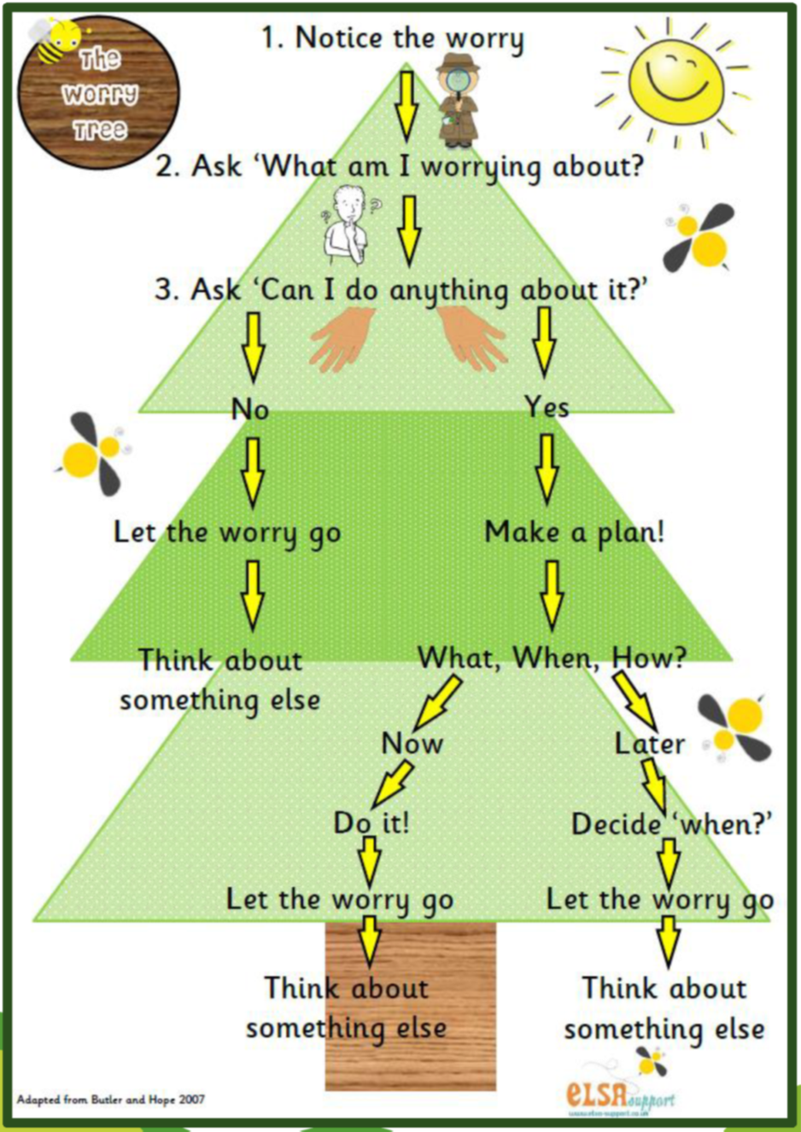
The Worry Tree

Slide 12
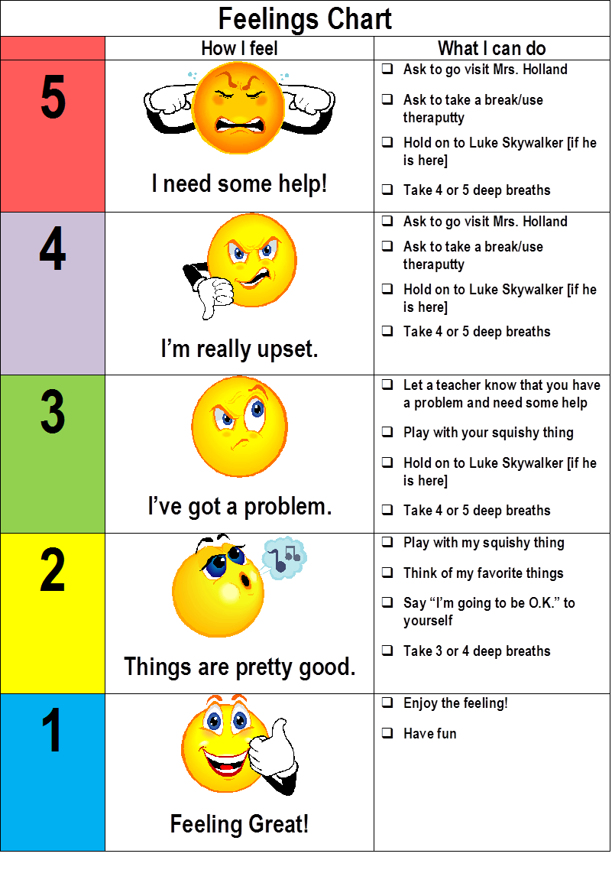
The Feelings Chart

Slide 13
https://www.epinsight.com/stress-self-care

Slide 14
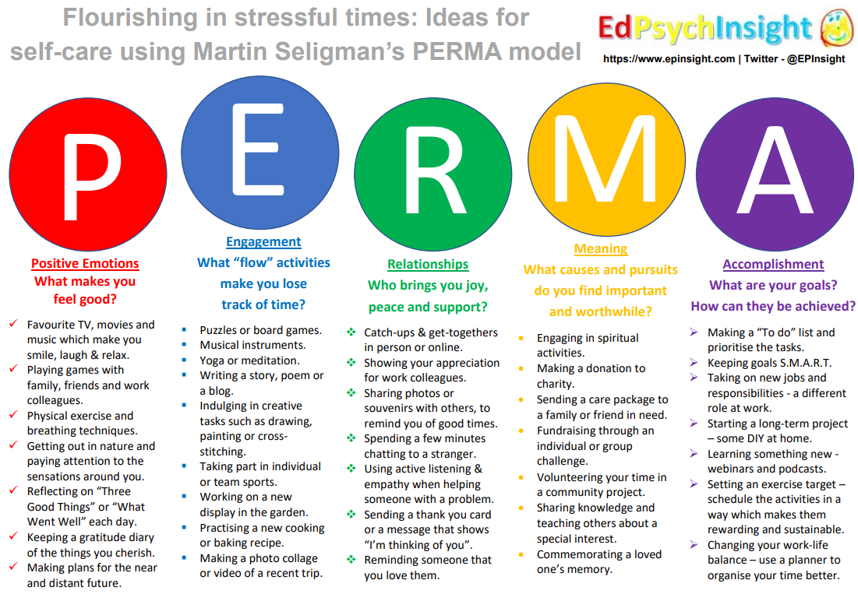
https://www.epinsight.com/stress-self-care

Slide 15
3 Steps to Emotion Coaching
Empathise, validate & label
1
Set limits (if needed)
2
Problem solving with the child or young person
3
Notes:
15

Slide 16
Sleep Hygiene Top Tips
Limit caffeine – especially after 12
Regular exercise
Cool, dark, quiet bedroom
Reduce blue wave light exposure in the evening
Quiet relaxing activities before bed
Turn off social media notifications when sleeping
Wake at the same time every day (including weekends)
Routine throughout the day – meals, activities
Bedtime routine / habits
Don’t go to bed hungry or too full
Realistic bedtime

Slide 17
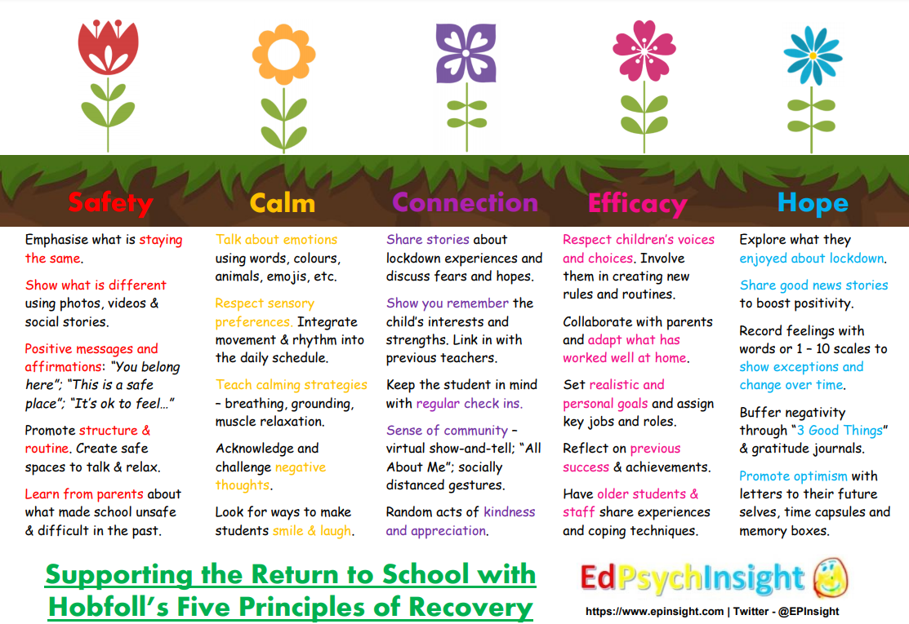

Slide 18
Social story example using Widget Symbol Software
Notes:
This is from a pack of free resources on the Widget website

Slide 19
Notes:
Anna Freud Centre

Slide 20
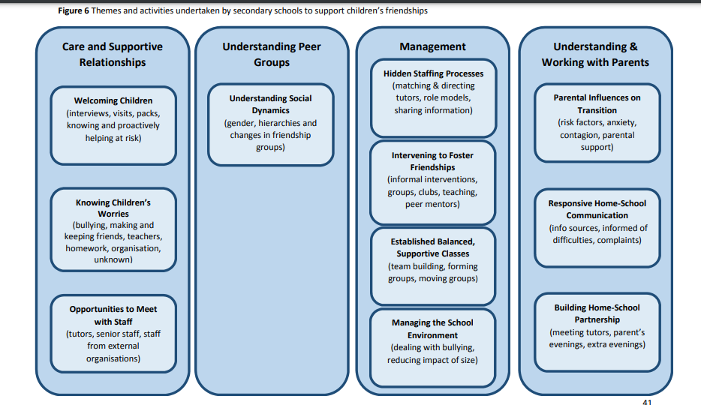
Notes:
These are themes that came up in interviews with staff about how friendships were supported around the transition.
Lots of information there…pick out a couple of key points
Note the importance of building relationships with parents
Staff talked about finding out from primary schools/current teachers or parents about pupils’ friendship groups and trying to ensure they move up with one or two friends wherever possible – can give them a sense of continuity when everything else is changing. And for some pupils this will be even more important – e.g. if they have difficulty forming friendships

Slide 21
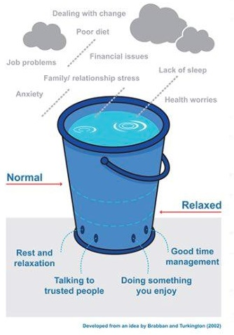
Look after yourself too!

Slide 22
Visit the Live Well site for signposting to more support
https://livewell.bathnes.gov.uk/coronavirus-information-advice-resources
Visit The Hub for more information on WER and to access all network session slides
https://thehub.bathnes.gov.uk/Page/20447
As of January 2022:
2021 to 2022 offer – supervision/reflective thinking sessions. Places booked now but more information to follow about future offers.
Notes:
During the coronavirus (COVID-19) outbreak many of us will experience times when our mental wellbeing suffers. Everyone reacts differently to difficult events but for everyone feelings of anxiety, low mood, loneliness, frustration and boredom are quite normal and to be expected from time to time. For those who already have a mental health problem, or who are in particularly challenging circumstances the outbreak may be especially difficult. The following sources of information provide ideas to help you look after your mental wellbeing and to find help when you need it.

Slide 23
Free sources of emotional support for frontline workers including education staff
Our Frontline www.mentalhealthatwork.org.uk/ourfrontline offers round-the-clock one-to-one support, by call or text, from trained volunteers, plus resources, tips and ideas to look after your mental health.
Shout provides a free 24/7 text support service for education and health staff who are working on the frontlines right now. Text FRONTLINE to 85258 to talk by text with a trained crisis volunteer
Wellbeing support by telephone for essential staff provided by Samaritans. Call free on 116 123 to speak in confidence with a trained listening volunteer
Frontline19 www.frontline19.com offers free online mental health and emotional wellbeing services to support frontline workers. You can access emotional support via Zoom, Skype or FaceTime with a fully qualified psychologist, psychotherapist or counsellor at a time that suits you for free

Slide 24
Acknowledgments
Clare Laker for asking us to become involved and coordinating the offer
The EPs for working swiftly and efficiently to develop and deliver the sessions within the context of the demands of a significant increase in statutory work
All educational staff who attended the sessions and used the advice line –
Resilience
Hope
Care
Skills
Please contact psychology_service@bathnes.gov.uk if you have any questions.

