Slide 1
Hayley Brimble
Specialist Autism Advisor

Slide 2
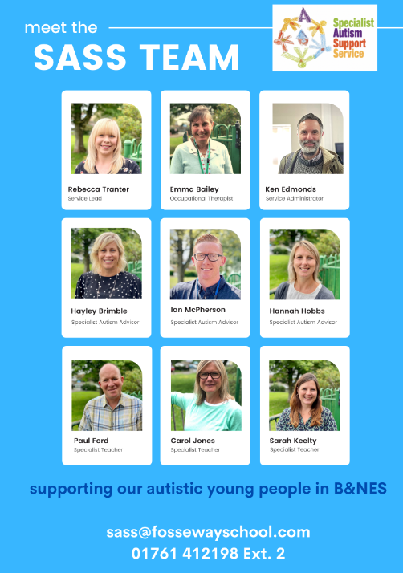
About us

Slide 3
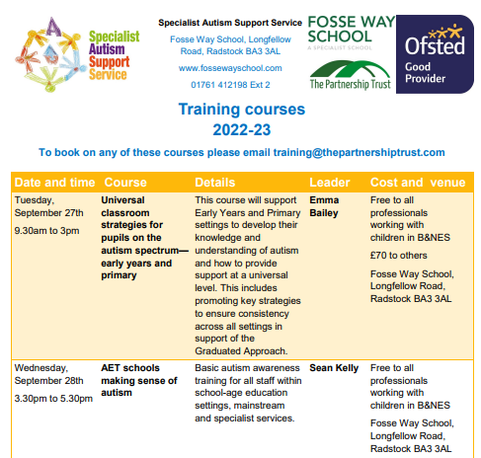
Training courses for professionals and parents

Slide 4
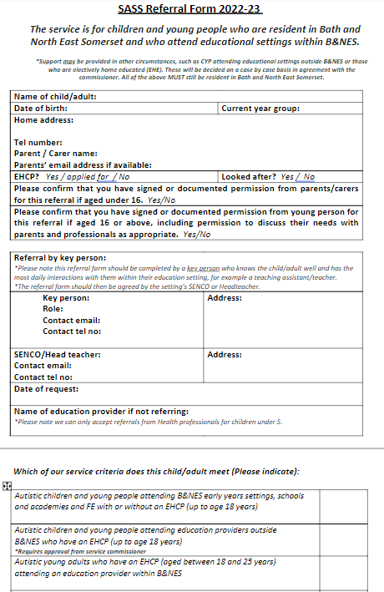
Each child per setting needs to be referred to SASS.

Slide 5
All information is on our PADLET

Slide 6
THANK YOU
Hayley Brimble
Specialist Autism Advisor (Early Years)
Specialist Autism Support Service
Fosse Way School
T: 01761 412198 | www.fossewayschool.co.uk
https://www.fossewayschool.co.uk/specialist-autism-support-service/

