Slide 1
Bright Start Children’s Centre Services Supporting families and children with Special Educational Needs and/or Disabilities (SEND)
Emily Didcott
Rebecca Wren

Slide 2
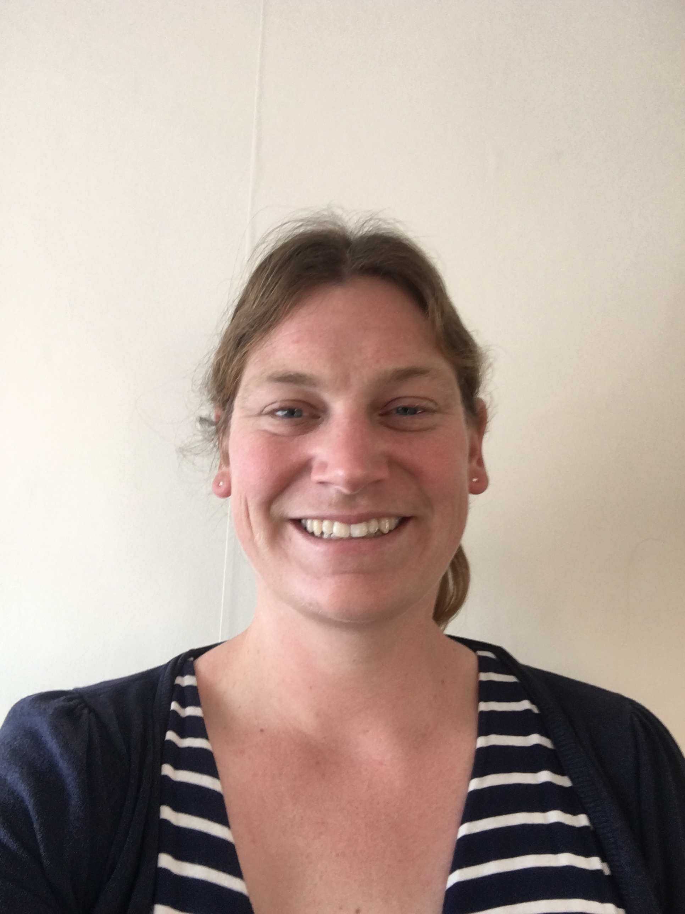
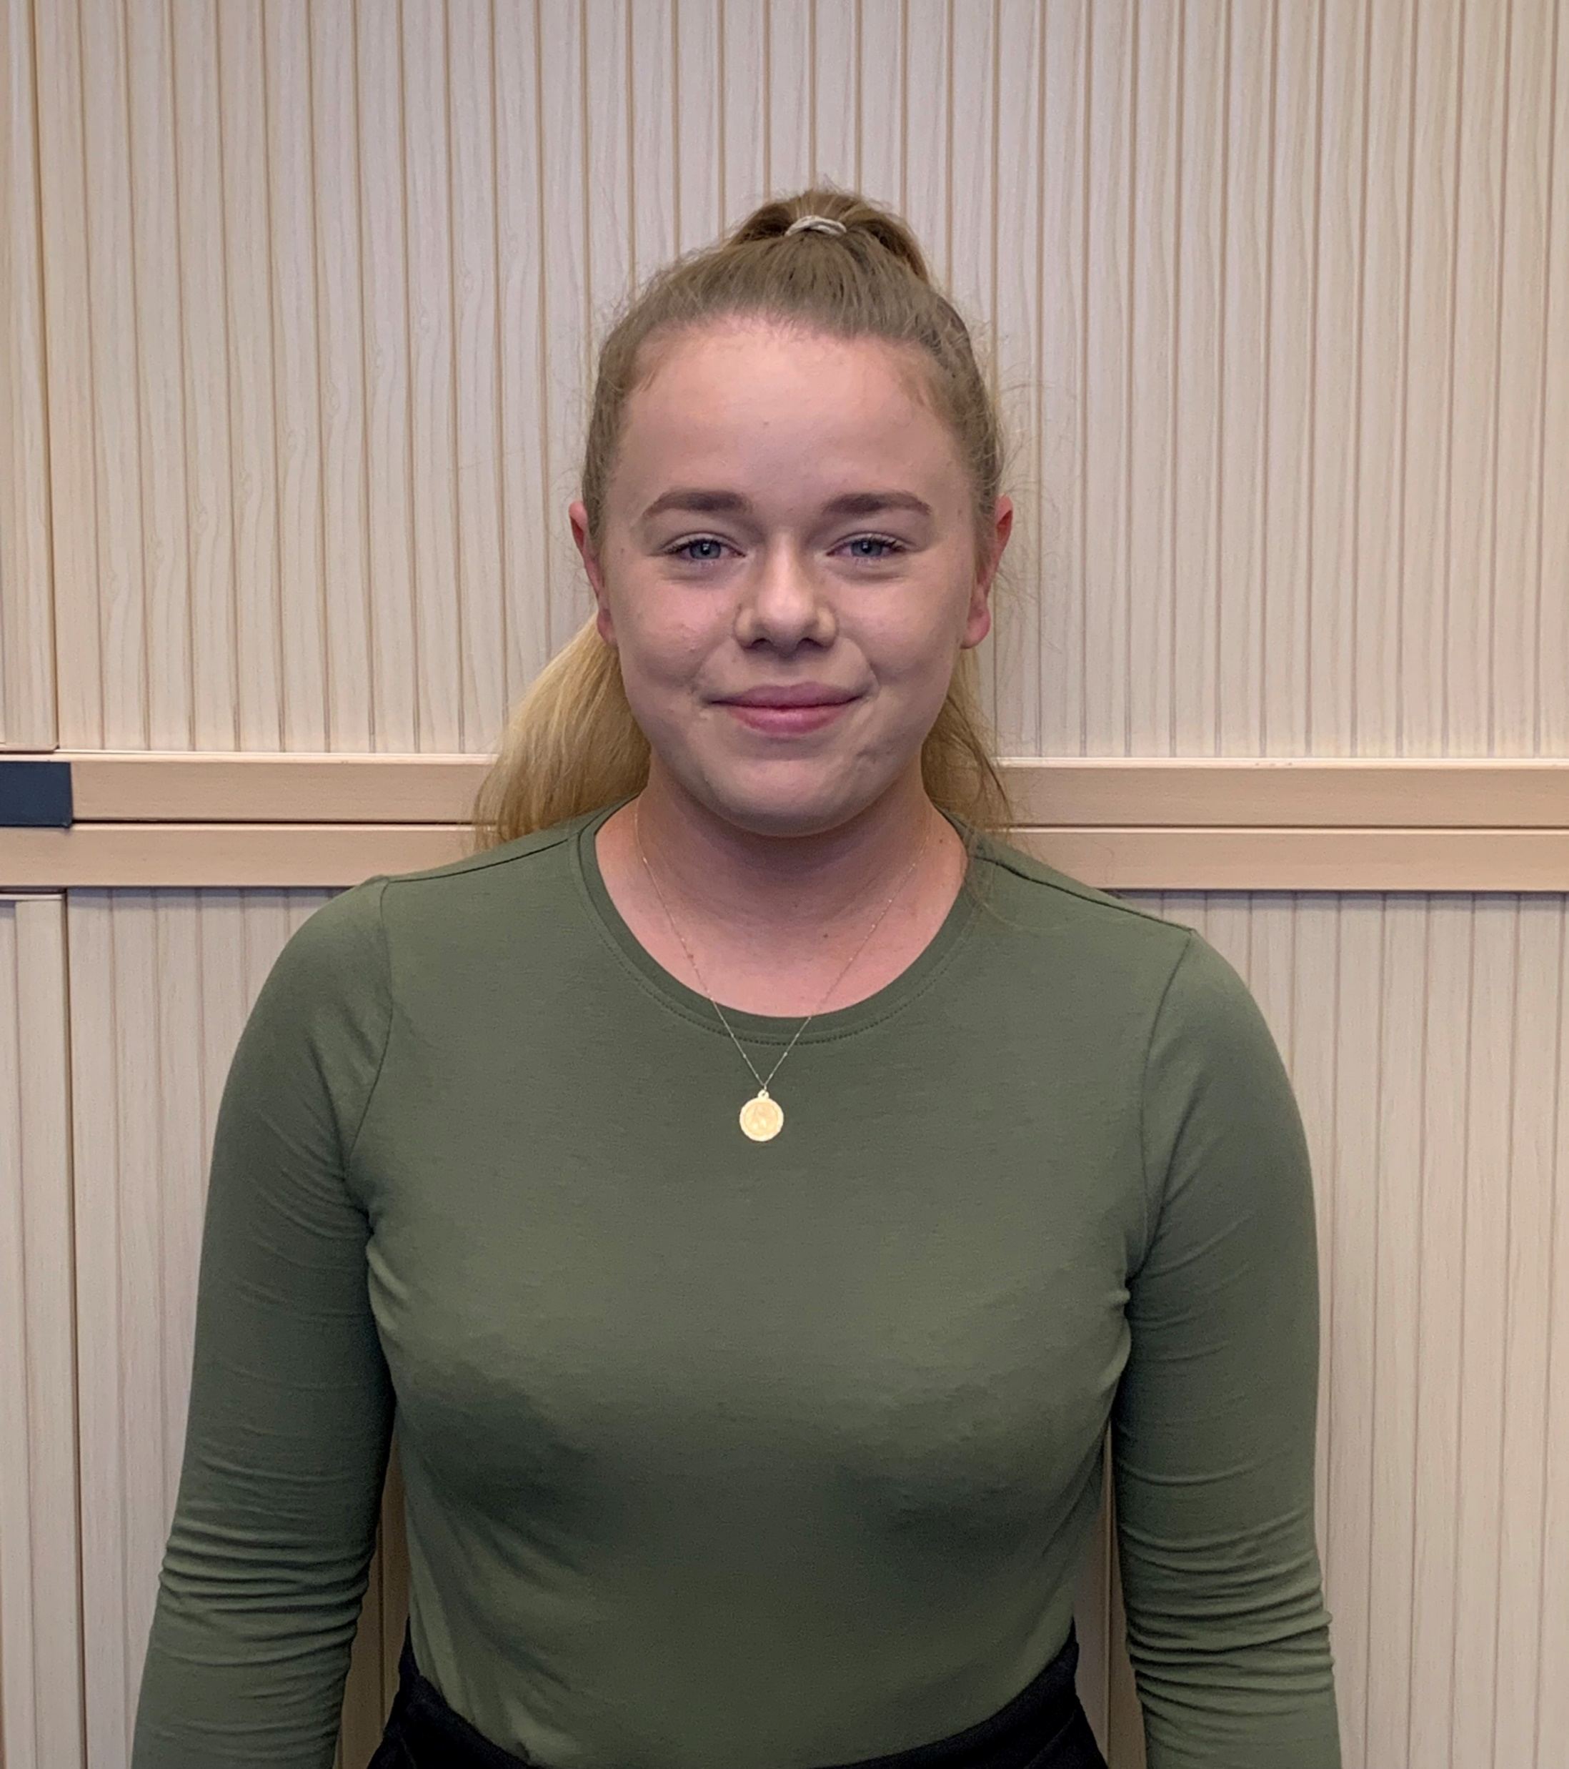
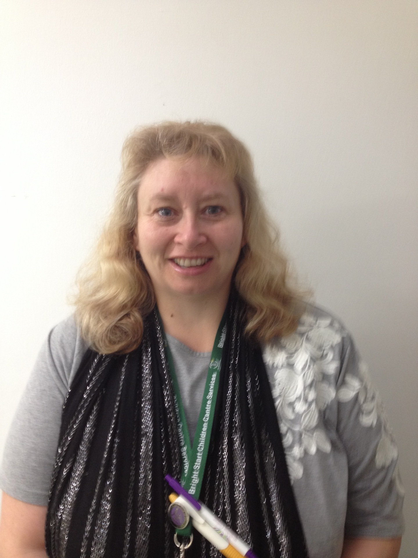
Specialist Portage Team
Emily Didcott
Children’s Centre Coordinator (SEND)
Leading on Speech and Language
01225 395400
Rebecca Wren
Lead outreach worker for SEND.
SEND Champion Bath
01225 396662
Emily O’Donnell
SEND champion Keynsham
01225 395400
Michelle Lander
SEND Champion Radstock
Leading on Autism
01225 396660

Slide 3
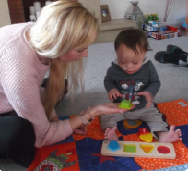
Our team provides a range of support for families with children who have an additional need or where there are concerns around a child’s development, including wellbeing, behaviour and mental health. Children do not need a diagnosis to access our service.

Slide 4
Portage
Portage is a home-visiting service for young children who have special educational and or additional needs, delivered by trained Portage practitioners.
We focus on what the child can do and empower parents/ carers to build on the child’s strengths
We work in partnership with other professionals to ensure we all work together for improved outcomes of the children that we are working with.
For more information on Portage visit www.portage.org.uk
Bright Start Children’s Centre is now recognised as a 5 Star Registered Portage Service

Slide 5
Flying Start
‘Flying Start’ is a 6-week play based programme in the home. ‘Flying Start’ helps parents find out more about what their child is good at and how they can support their child’s learning and development. It can really help children to have a positive start to their early years setting, whether that’s with a childminder, nursery or preschool/school.

Slide 6
Family Support
Our Family Support Workers can offer practical support and advice on a wide range of issues.
We will also signpost to professionals and agencies that may be able to better support a family.
Working alongside settings and Childminders in a joined up approach.

Slide 7
Step by Step
The Step by Step Programme is an 8 week programme, designed to support parents/carers of a child, over 2 years, with additional needs. Each week a professional from a key area attends, to introduce their service, answer questions and help families to access the services that families may need, to support them and their children with their learning

Slide 8
Step in to School
A four week course, for parents and carers who’s child has additional needs/ SEND and is due to start school.
It includes
School readiness - what does this mean and what does it look like?
How to prepare children for school
Available services and support

Slide 9
Ready Steady Talk
A 6 week course for families with Children 18m to 3 yrs promoting communication & language development through play.

Slide 10
Any questions?

Slide 11
Bright Start Children’s Centre Services
Bath Children & Family Centre
12 Charlotte Street, Bath, BA1 2NE
Tel: 01225396662
Radstock Children & Family Centre
Hope House Centre, 10 Waterloo Road, BA3 3EP
Tel: 01225396660
Keynsham Children & Family Centre
65 West View Road, Keynsham, BS31 2UE
Tel: 01225395400
Email: brightstartcc@bathnes.gov.uk
www.bathnes.gov.uk/childrens-centres

