Slide 1
Early Years Area SENCo team
New SENCo – Graduated approach

Slide 2
Legislation Alert
The SEND Code of Practice 2015 states:
It is particularly important in the early years that there is no delay in making any necessary special educational provision.
The benefits of early identification are widely recognised – identifying need at the earliest point, and then making effective provision, improves long-term outcomes for children.
Providers must have arrangements in place to support children with SEN or disabilities.
These arrangements should include a clear approach to identifying and responding to SEN.
In particular, parents know their children best and all practitioners MUST listen and understand when parents express concerns about their child’s development.
Settings should also listen to and address any concerns raised by children themselves.
All settings should adopt a graduated approach with four stages of action: assess, plan, do and review.

Slide 3
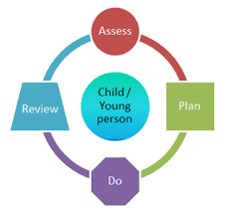
The Graduated Approach
The graduated approach is a four stage cycle, set out in the Special educational needs and disability code of practice (2015).
It set’s out steps that should be taken if there is a concern about a child’s development over one or more of the four broad areas of:
Communication and Interaction
Cognition and learning
Social, emotional and mental health
Physical and sensory
The graduated approach supports early identification and effective support for children, and it values the voice of the child by seeking to include input from all relevant people in the child’s life.
Let’s look at each stage in more detail.

Slide 4
Assess
Code of practice states:
Your response:
“In identifying a child as needing SEN support, the early years practitioner, working with the setting SENCO and the child’s parents, will have carried out an analysis of the child’s needs. This initial assessment should be reviewed regularly to ensure that support is matched to need. Where there is little or no improvement in the child’s progress, more specialist assessment may be called for from specialist teachers or from health, social services or other agencies beyond the setting. Where professionals are not already working with the setting, the SENCO should contact them, with the parents’ agreement.”
This is the stage for further exploration, it can also overlap with the early intervention discussed previously. At this stage the Key Person works with the setting SENCo and the child's parents to:
Bring together all the information gathered during universal setting assessments, 2-year progress check and observations carried out within their universal inclusive practice.
This can then be used to begin to understand the needs of the child, and begin to plan what might be supportive.

Slide 5
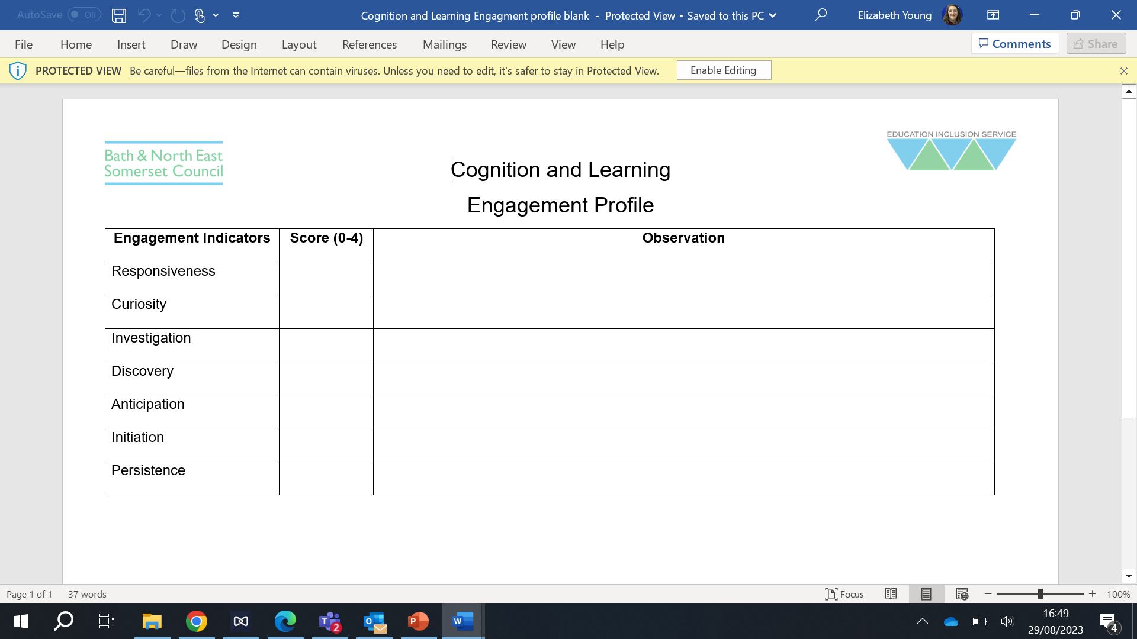
Tools to support you at the ‘Assess’ stage
Every Child a Talker - ECaT
Leuven scales
Engagement profile

Slide 6
Plan
Code of practice states:
Your response:
Agree outcomes that everyone is seeking for the child.
Decide what the support will be and how it will be delivered..
Consider the expected impact on progress, development, behavior
Decide a date for the review.
Plans should:
Take into account the views of the child
Be appropriate for the child’s stage of development.
Be widely recognized and have reliable evidence of effectiveness.
Be delivered by practitioners with relevant skills and knowledge.
Identify and address any related staff or team training needs.
“Where it is decided to provide SEN support, and having formally notified the parents, the practitioner and the SENCO should agree, in consultation with the parent, the outcomes they are seeking, the interventions and support to be put in place, the expected impact on progress, development or behaviour, and a clear date for review. Plans should take into account the views of the child. The support and intervention provided should be selected to meet the outcomes identified for the child, based on reliable evidence of effectiveness, and provided by practitioners with relevant skills and knowledge. Any related staff development needs should be identified and addressed.”

Slide 7
Tools to support you at the ‘Plan’ stage
Provision planner
Completed engagement profile
Completed one page profile
Shared information
Knowledge of schemas

Slide 8
Do
Code of practice states:
Your response:
“The early years practitioner, usually the child’s key person, remains responsible for working with the child on a daily basis. With support from the SENCO, they should oversee the implementation of the interventions or programmes agreed as part of SEN support. The SENCO should support the practitioner in assessing the child’s response to the action taken, in problem solving and advising on the effective implementation of support.”
The practitioner, usually the child’s key person:
Carry’s out the agreed support
Maintains active communication with parents/carers each session/week.
Records what they notice.
The SENCo supports the practitioner to:
Reflect on the support process and make necessary adaptations.
Problem solve.

Slide 9
Review
Code of practice states:
Your response:
“The effectiveness of the support and its impact on the child’s progress should be reviewed in line with the agreed date. The impact and quality of the support should be evaluated by the practitioner and the SENCO working with the child’s parents and taking into account the child’s views. They should agree any changes to the outcomes and support for the child in light of the child’s progress and development. Parents should have clear information about the impact of the support provided and be involved in planning next steps.”
On the agreed date, the key adult, SENCo and parents/carers should:
Review how the support has helped.
Celebrate progress and achievement and notice any area’s that could use more or different support.
On review, all agree:
Any new outcomes or changes to targets
Any changes to the support
Next steps
This includes taking any views expressed by the child into account.

Slide 10
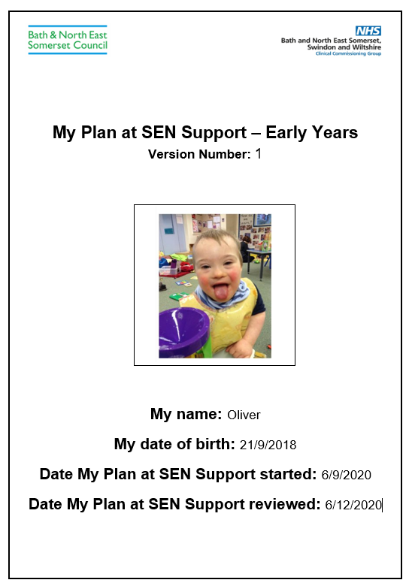
Evidencing the Graduated Approach in B&NES My Plan at SEN Support
Part 1: Personal Details
Part 2: Child’s Voice (One Page Profile)
Part 3 : Parent Carer views
Part 4: Observe and Assess
Part 5: Plan and Do
Part 6: Outcomes
Part 7: Progress Review Tool
Part 8: Review of Plan
The graduated approach will be carried out and reviewed about every six weeks and the ‘My plan’ should be refreshed and updated every two cycles of the graduated approach.
You can actively demonstrate the process of working as a whole team around the child, by including parent/carer views, partnership working and the voice of the child.

Slide 11
Recap and reflect
The graduated approach is a ‘best practice’ way of ensuring you seek to identify and support emerging needs and SEN.
The SENCo’s role is to lead and coordinate the Graduated Approach across the setting and ensures shared understanding of it across the setting.
The graduated approach is a cycle with 4 stages of action.
Is usually led by the keyperson and supported by the setting SENCo.
Parents are engaged throughout this cycle.
Action is informed by the child’s views throughout – child centered.
The cycle can be revisited in order to celebrate progress and identify what else might be supportive.
The graduated approach is as effective as you make it.

