Slide 1
Early Years Area SENCO Team
New SENCo - Professional Partnerships

Slide 3
Why are Professional Partnerships important?
Partnership working is essential to ensure children have their needs identified, assessed and met throughout their childhood. Building good professional connections reduces working in isolation and provides a holistic view of children and families. This in turn can support high aspirations for children and better outcomes.
Legislation Alert
‘Where a child continues to make less than expected progress, despite evidence based support and interventions that are matched to the child’s area of need, practitioners should consider involving appropriate specialists, for example, health
visitors, speech and language therapists, Portage workers, educational psychologists or specialist teachers, who may be able to identify effective strategies, equipment, programmes or other interventions to enable the child to make progress
towards the desired learning and development outcomes.
The decision to involve specialists should be taken with the child’s parents’
(SEND Code of Practice 2015, 5.48)

Slide 4
Health Visiting

Slide 5
Service offer
Health Visitors work with families and communities to improve access, experience, outcomes and reduce health inequalities.
Health Visitors and School Nurses lead the Healthy Child Programme, The Healthy Child Programme offers every family an evidence-base programme of interventions, including screening tests, immunisations, developmental reviews, and information and guidance to support parenting and healthy choices. It also outlines all services that children and families need to receive if they are to achieve their optimum health and wellbeing.
Universal Plus Service (Targeted Support )- Families are assessed as requiring brief intervention to address an identified need, which is anticipated to require a maximum of 6 contacts, by Health Visitor, Early Years Community Practitioner.
This can be support with: Mild to moderate postnatal depression (PND) requiring up to 6 Health Visitor listening visits, Breastfeeding support, Sleep problems, Healthy eating/ introduction to solid foods, Toilet training and Supporting speech, play and development.

Slide 6
How to refer and contact information
To Refer:
Contact Locality Team Office number to discuss with Duty Health Visitor if Named HV not known. Can offer anonymous advice but if specific child then parental consent needs to be given for contact.
Locality Team Office Contact Numbers:
CENTRAL SERVICE NUMBER: 01225 831794
Bath South Health Visiting Team Tel: 01225 831694
Keynsham HV Team Tel: 0117 9461076
Chew Valley HV Team Tel: 01225 613887
Somer Valley HV Team Tel: 01761 408358
Parkside Health Visiting Team Tel: 01225 831829
B&NES Health Visiting Webpage: https://bathneshealthandcare.nhs.uk/childrens/health-visiting/
B&NES Baby and Toddler Hubs Facebook page: https://www.facebook.com/banesbabyhubs/
Reflection point
When might you think about referring to the health visiting team?

Slide 7
Bright Start Children’s Centre Services Supporting families and children with Special Educational Needs and/or Disabilities (SEND)

Slide 8
Service offer
The service provides a range of support for families with children who have an additional need or where there are concerns around a child’s development, including wellbeing, behaviour and mental health.
Support packages that can be available to families:
Portage – a home-visiting service for young children who have special educational and or additional needs, delivered by trained Portage practitioners. We focus on what the child can do and empower parents/ carers to build on the child’s strengths
Flying Start – a 6-week play based programme in the home. Flying Start helps parents find out more about what their child is good at and how they can support their child’s learning and development.
Family Support – offer practical support and advice on a wide range of issues. We will also signpost to professionals and agencies that may be able to better support a family. Working alongside settings and Childminders in a joined up approach.
Step by Step – an 8 week programme, designed to support parents/carers of a child, over 2 years, with additional needs. Each week a professional from a key area attends, to introduce their service, answer questions and help families to access the services that families may need, to support them and their children with their learning.
Ready Steady Talk - a 6 week course for families with children 18 months to 3 years promoting communication & language development through play.

Slide 9
How to refer and contact information
To Refer:
Parents and carers can refer by:
Contact your Health Visitor or Social Worker
Speak to your child’s nursery, childminder or any other service involved
Contact your local Children’s Centre
By emailing brightstartcc@bathnes.gov.uk
Professionals can refer by following the link below and completing the online form:
https://www.bathnes.gov.uk/webforms/childrens-centre-services-request-for-support/
Bath Children & Family Centre
12 Charlotte Street, Bath, BA1 2NE
Tel: 01225396662
Radstock Children & Family Centre
Hope House Centre, 10 Waterloo Road, BA3 3EP
Tel: 01225396660
Keynsham Children & Family Centre
65 West View Road, Keynsham, BS31 2UE
Tel: 01225395400
Email: brightstartcc@bathnes.gov.uk
www.bathnes.gov.uk/childrens-centres
Reflection point
Can you think of any families you are working with that would benefit from one of these support packages?

Slide 10
Specialist Autism Support Service (SASS)

Slide 11
Service offer for early years
Specialist Autism Support Service (SASS) supports the following children and young adults up to the age of 25, with a B&NES home address:
Autistic children and young people with a B&NES home address attending B&NES early years settings, without an EHCP.
Children and young people with B&NES home address, attending education providers outside B&NES who have an EHCP
Parents, carers and families of the autistic children within B&NES.
Professionals working with the autistic children and young adults above
The service offers:
advice and support with practical strategies and resources for providers, professionals and families
collaboration with other agencies and provide sign posting where required
transition advice and support when requested and have produced resources to support with transition
training and continuing professional development for professionals using AET training modules (www.autismeducationtrust.org) and support the vision, mission and values of the Autism Education Trust.
autism-specific training and continuing professional development for professionals using open or bespoke training options,
offer autism-specific training opportunities for parents and families

Slide 12
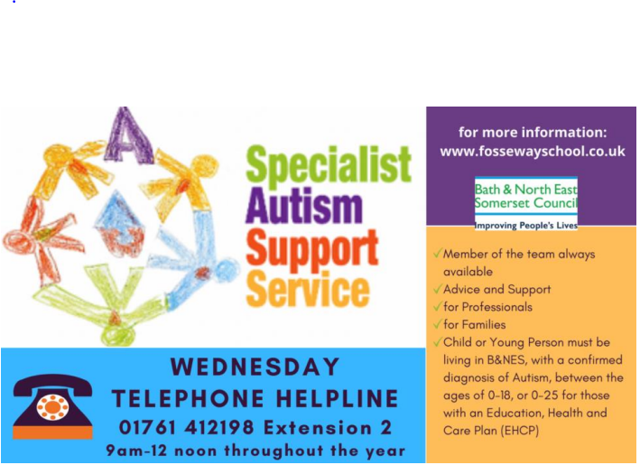
How to refer and contact information
Specialist Autism Support Service
Fosse Way School
T: 01761 412198
E: sass@fossewayschool.com
www.fossewayschool.co.uk
https://www.fossewayschool.co.uk/specialist-autism-support-service/
To Refer:
For education settings to refer individuals to the service there is a referral form that needs to be completed. Each child per setting needs their own referral.
The referral form can be found under referral process section: https://www.fossewayschool.co.uk/specialist-autism-support-service-2/
To request training use training request form for use when requesting organisational training or CPD, in addition to courses which can be booked through: https://thepartnershiptrustcpd.co.uk/
Reflection point
Do you have children in your setting with an autism diagnosis, who would benefit from this support?
For further information on SASS and their services please follow this link: offer autism-specific training opportunities for parents and families and also the padlet: https://padlet.com/SASSBathnes/sass-updated-documents-4fxo0z0f9y5iv5sy

Slide 13
B&NES Children’s Community Services

Slide 14
B&NES Children’s Community Services:
Service offer.
Audiology- provide hearing assessments, using techniques that are age appropriate to the child. Children with permanent hearing loss are seen regularly for monitoring and hearing aid support and meet with teachers from the sensory support services
Bladder and Bowel Service- Children’s Specialist Continence Nurses are based in the community to provide assessment, support and treatment for children with delayed toilet training, bed wetting, day time wetting, constipation and soiling.
Community Paediatrics- operates community clinics across Bath seeing young people who have been referred from their GP or other healthcare professional with developmental, behavioural, medical or educational needs.
Speech and language therapy- Children’s Speech and Language Therapy Service provides a high quality speech and language therapy service to children and young people with speech, language, communication, feeding and swallowing difficulties.
For further information on services available follow the link: https://bathneshealthandcare.nhs.uk/childrens/

Slide 15
How to refer and contact details
The Single Point of Entry (SPE) Form is the form used when referring to outside agencies such as Speech and Language Therapy and Paediatrician.
To access this form, you must go to the Single Point of Access pathway and contact health and care services to request a referral.
https://bathneshealthandcare.nhs.uk/childrens/spa/
You must include in detail the child’s strengths and needs as well as what has already been tried to support them. You will also need to include what you and the parents/carers hope to happen as a result of the referral. You can also send additional information to support this referral such as assessments, professional reports, and further information about the child.
Reflection point
At what point might you think about making a referral to one of these services and why?

Slide 16
Virtual Schools
Service offer
Virtual School provides educational support to children in care from nursery to the end of full-time education.
We monitor and support the progress of children in care, as though they were in a single, virtual school. We work with carers, social care, SEND support services and over 100 schools and colleges to help every child or young person achieve their potential.
Referral and contact information
To contact Virtual School follow the link below and complete the online form:
https://beta.bathnes.gov.uk/form/contact-the-virtual-school

Slide 17
Sensory Support Service
Service offer
Support for children and young people who are deaf, have vision or multi-sensory impairment. Sensory support helps children and young people to learn at home, in early years settings and schools by working with families and a range of professionals. Sensory Support Service will support your family at home and help your child’s early years setting or school by providing:
assessment of your child’s educational needs
support families to promote their child's development
training and support so that your child is fully included in the early years setting, school or other educational setting and makes good progress
direct support and teaching for children who need to learn specialist skills, such as Braille
advice and support to help your child develop independence and life skills
Referral and contact information
Sensory Support Service Elmfield House Greystoke Avenue Westbury-on-Trym BS10 6AY
Phone: 0117 903 8442 Text: 07407 814 763 Email: sensorysupportservice@bristol.gov.uk
For information on how to refer to the Sensory Support Service follow the link below:
https://www.bristol.gov.uk/sensory-support-service/about/referrals

Slide 18
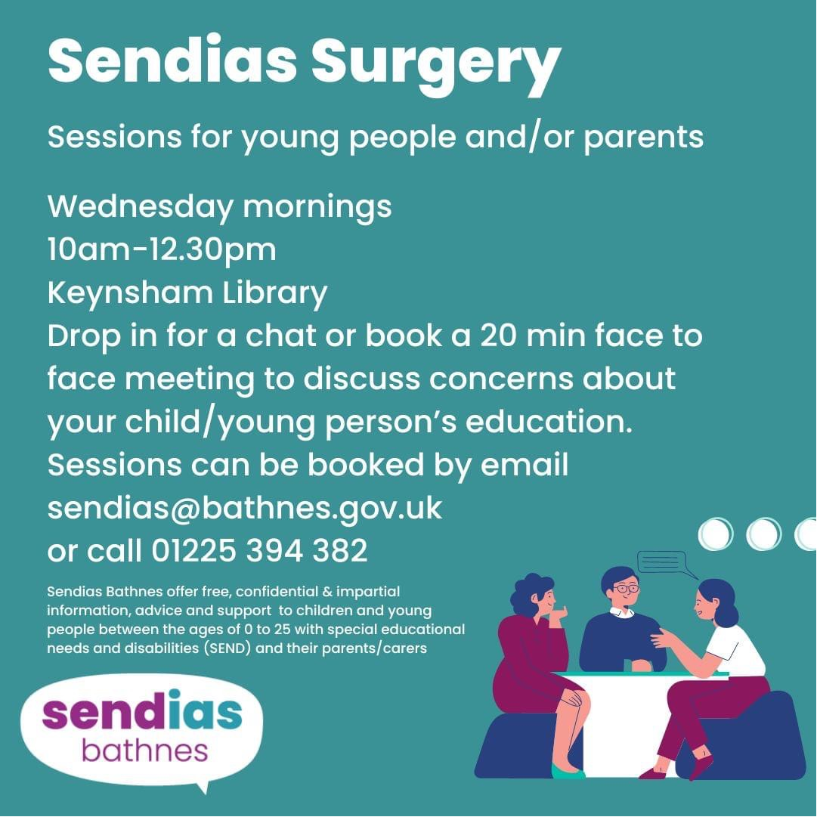
SENDIAS Bath &North East Somerset
Support children and young people with special educational needs and disabilities (SEND) and their parents and carers.
They offer free, impartial and confidential information, advice and support to children and young people between the ages of 0 to 25 with special educational needs and disabilities (SEND) and their parents/carers.

Slide 19
Other services relevant services
Special Educational Needs and Disability Inclusion Panel (SENDIP) - All things SEND funding related To request for inclusion or transition support funding for a child, review ISF/TSF, disability access funding.
Statutory SEN Team – Oversee and facilitate EHCP processes from needs assessment to review.
EYFS Team – Work with the early years sector to strive and reflect the visions and values of BANES council to achieve the best outcomes for children.

