Slide 1
Health Visiting Update to B&NES Early Years SENCo training
Mandy Dams Clinical Team Lead Health Visiting
Line Managing Keynsham and Chew Valley Teams
Represents service on SEND Inclusion Panel

Slide 2
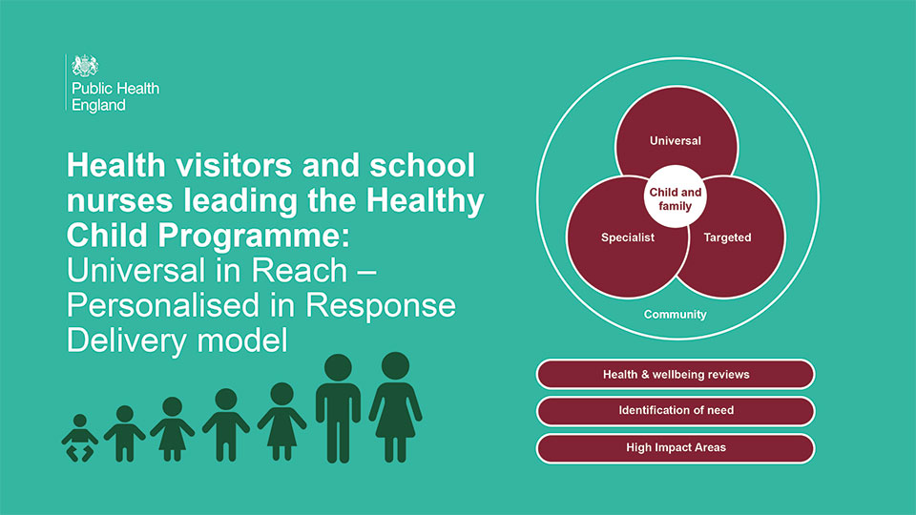

Slide 3
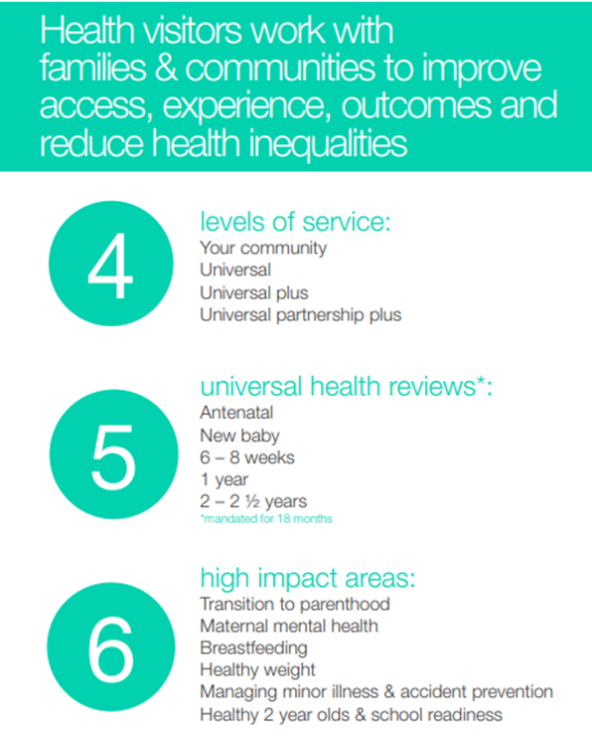
Delivery Model
‘Universal in reach – Personalised in response’ superceded 456 Model in 2021
Universal, Universal Plus and Universal Partnership Plus NOW universal, targeted and specialist service

Slide 4
Healthy Child programme
The Healthy Child Programme offers every family an evidence-base programme of interventions, including screening tests, immunisations, developmental reviews, and information and guidance to support parenting and healthy choices. It also outlines all services that children and families need to receive if they are to achieve their optimum health and wellbeing.
The Healthy Child Programme remains universal in reach continuing to set out a range of public health interventions to build healthy communities for families and children, reducing inequalities and vulnerabilities. Focuses on early intervention and prevention.
Health visitors lead the 0 to 5 element of the Healthy Child Programme

Slide 5
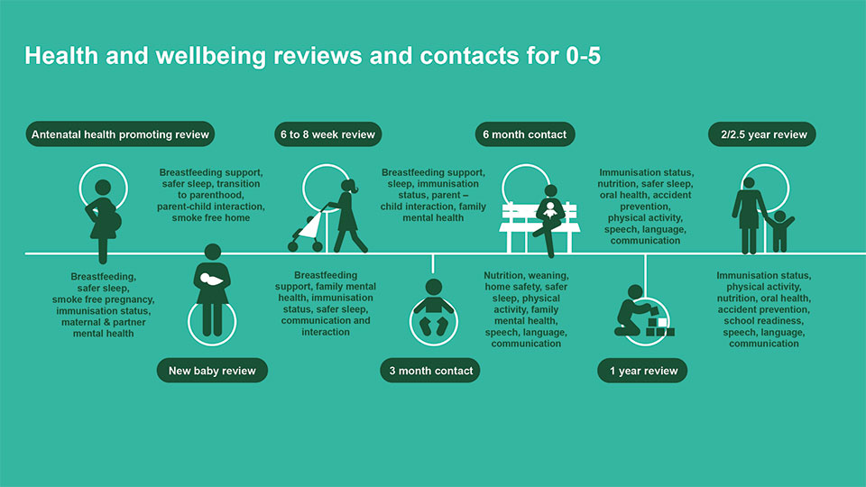
Universal contacts

Slide 6
Targeted (Universal Plus Service)
Where a family is assessed as requiring brief intervention to address an identified need, which is anticipated to require a maximum of 6 contacts, by Health Visitor, Early Years Community Practitioner.
Mild to moderate postnatal depression (PND) requiring up to 6 Health Visitor listening visits
Breastfeeding support
Sleep problems
Healthy eating/ introduction to solid foods
Toilet training
Supporting speech, play and development

Slide 7
Specialist (Universal Partnership Plus Service)
Ongoing support from the health visiting team and a range of local services to support more complex issues over a period of time. These include services from Children’s Social Care, Children’s Centres, Early Years Settings and other Early Help services.
Examples
● Child Protection Plan
● Child in Need Plan
● Children on a Supervision Order
● Looked after Children
● Children with an Early Help Assessment (formerly CAF)
● Children who have complex additional needs due to developmental delay, life limiting illness, disability or special educational needs requiring a ‘My Plan’.

Slide 8
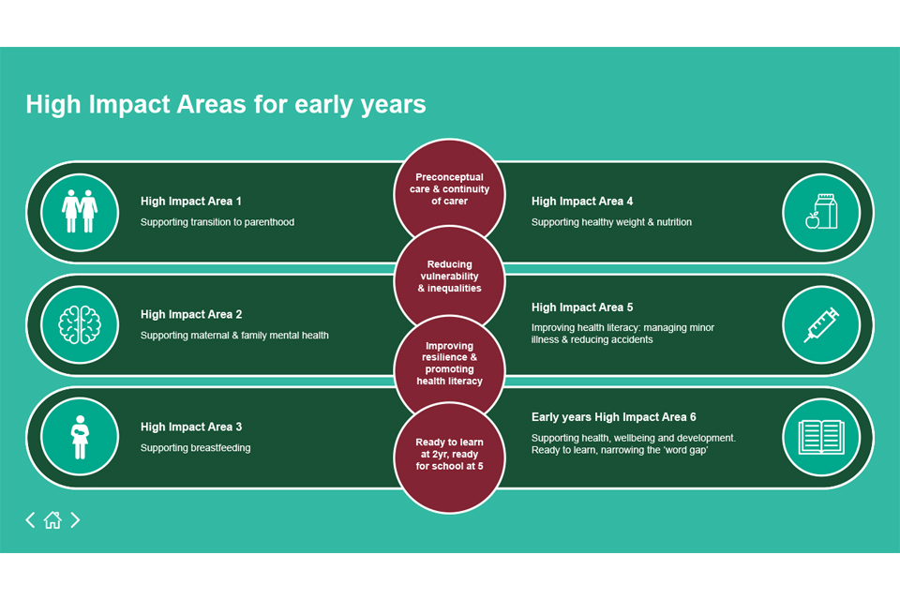

Slide 9
SEND and service level support
Universal
Assessment (including ASQs at 1 and 2 years) and referral (5 core contacts)
Targeted (Universal Plus)
Assessment, support packages for school readiness include Play and Communication, Toileting and referral
Specialist (Universal Partnership Plus)
Assessment (including Ages and Stages questionnaires), referral, family support, signposting to community resources/3rd sector, Team around the Child, Lead Professional (usually up to 2 years), contribution to Inclusion Funding requests

Slide 10
Referrals/updates/waiting times
Changes in Locality Team Staffing and capacity
Links to Early Years Settings/named Health Visitor
Referrals: Contact Locality Team Office number to discuss with Duty Health Visitor if Named HV not known. Can offer anonymous advice but if specific child then parental consent needs to be given for contact.
Waiting Times for review &/or Support packages
Moving towards a Single Point of Access – one contact number across B&NES to contact Health Visiting

Slide 11
Locality Team Office Contact Numbers
CENTRAL SERVICE NUMBER: 01225 831794
Bath South Health Visiting Team Tel: 01225 831694
Keynsham HV Team Tel: 0117 9461076
Chew Valley HV Team Tel: 01225 613887
Somer Valley HV Team Tel: 01761 408358
Parkside Health Visiting Team Tel: 01225 831829
B&NES Health Visiting Webpage: https://bathneshealthandcare.nhs.uk/childrens/health-visiting/
B&NES Baby and Toddler Hubs Facebook page: https://www.facebook.com/banesbabyhubs/

