Slide 1
Early Years Area SENCo Team
That’s the SENCo’s Job?
Day 2: Crossing all the T’s!
Part 1: Transitions And Team Around the Child (TAC)
Wednesday 11th January 2023

Slide 2
Hello Everyone ☺ Please be familiarising yourself with the Zoom Training Etiquette while you wait for the training session to begin.
Please ensure that where possible you are wearing headphones as this will keep distractions and external noise levels to a minimum
Be open to and respectful of other people’s opinions and suggestions
Please remain muted until the session leader advises you to unmute. This avoids any difficulty with overlapping speech.
Please be mindful to listen to your colleagues when they are voicing their ideas or sharing experiences!
It may be that there will be anecdotal references made to families and children with which you are working. When referring to particular children please use initials only.
Please remember that this information is confidential and should not be discussed outside of this Zoom room
Notes:
Lizzie

Slide 3
Feedback from self reflection audit
Notes:
Lizzie

Slide 4
Aims of the session
Have a deeper understanding of the importance of well supported transitions and understand the difference between the different types of transitions children (and adults) experience every day.
Understand why effective leadership of Team Around the Child meetings is so important and how they can help to support parents and children to celebrate successes and progress and plan for children’s ongoing development.
Develop a greater understanding of the difference between targets and outcomes and gain confidence in how to set meaningful targets and effectively review then using the strengths based approach.
Introduce professional partner to enable SENCos to know how and who to link with to enable multi agency working.
Gain awareness of training that supports the whole setting approach to supporting children with SEND and will promote higher levels of confidence and confidence within mainstream group based settings.
Notes:
Lizzie

Slide 5
DAY 2: Crossing all the T’s
9.30am – 9.35am : Intros and Aims
9.35am – 9.45am: Feedback from Task
9.45am – 10.45am: Transitions: Understanding and Supporting
Break: 10 mins
10.55am – 11.55pm Team Around the Child and Tricky Conversations
Lunch break: 12.00pm – 12.30pm (30 mins)
12.30pm – 1.15pm Targets and Outcomes
1.15pm – 2.40pm Tapping into professional support: Guest speakers
Break: 5 mins
2.45pm – 3.15pm. Training: Whole team CPD opportunities
3.15pm – 3.30pm: Round up of the day and finish
Notes:
Lizzie

Slide 6
Transitions
Notes:
Bobbie

Slide 7
Notes:
Start off with those visual as gives good overview of transitions from birth through life that effect all of us.
Read through slide

Slide 8
Self Reflection & Breakout Activity 1:
Managing transitions
Can you think of a time when you have had to manage a transition of your own?
What feelings did you experience?
How did you manage these feelings?
Who or what supported you through this transition and how?
Notes:
Bobbie: Couple of minutes thinking time then BR send into Breakout rooms to discuss experiences if comfortable to do so – donthave to be negative experiences
Doesn’t have to be different form everyone elses,s
Ca experience the same transition but have totally different experience/emotional and physical

Slide 9
What do we mean by transition in Early Years?
High quality transitions recognise the importance of feeling “known”.
Key to a high-quality experience for all children in the early years is ensuring continuity between home, key people and all the settings that make up children’s individual learning journeys. In today’s society children may have many out-of-home experiences, through childcare, toddler groups, family day care and more than one nursery, and they may appear to straddle change with ease. But while transitions may occur with great frequency, not all children navigate these comfortably or happily.
Birth to 5 Matters 2021
Notes:
Bobbie: Talk through visual and quote

Slide 10
SEN support should include planning and preparing for transition, before a child moves into another setting or school. This can also include a review of the SEN support being provided or the EHC plan. To support the transition, information should be shared by the current setting with the receiving setting or school. The current setting should agree with parents the information to be shared as part of this planning process.
The Early Years Ofsted Inspection Handbook 2021 states that settings will be rated as inadequate in Personal Development criteria if: ‘Practitioners do not support children’s social and emotional well-being or prepare them for transitions within the setting and/or to other settings and school’

Slide 11
Types of Transition
Types of transition | Explanation
Horizontal Transitions | Refer to the daily changes and experiences a child may go through, e.g. moving from one activity to another, such as from indoor to outdoor play. It can include a change in movement or routine.
Micro transitions (within Horizontal) | Are smaller transitions that fall under the horizontal transition. An example may be that of a key person leaving the room and returning throughout the session. These types of transitions can often be overlooked but often have an emotional impact on the child, particularly if they are not prepared for such uncertainty.
Vertical Transitions | Are much more significant and linked to specific events that do not happen on a regular basis, e.g. moving into shared setting, Reception and through each school year.
Associated Transitions | Refer to the fewer formal changes in children's lives that may occur outside of educational settings but can affect children's well-being e.g. divorce, particularly if the child has to move between one parent and another.
SEND transitions | Refers to the additional experiences that a child may need to manage e.g. attending appointments, experiencing visitors into the home or settings, medical support, transport support, attendance of specialist and mainstream provision. It is this type of transition that add additional physical and emotional pressures on the child and family.

Slide 12
Horizontal Transitions during the preschool day
Notes:
Type into chat examples of horizontal transitions - Also include micro transitions – key person going for lunch – covering a different room – being picked up unexpectedly, visitors to the setting

Slide 13
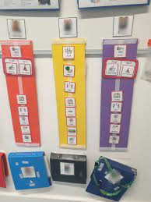
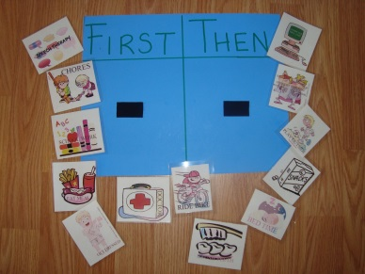
Resources to help support successful daily transitions
Notes:
Type in chat others used at your setting if not shown on visual - Most important resources is the keyperson and other setting staff.

Slide 14
Vertical transitions
Home
Childminder
Nursery/preschool
Reception
EYFS – KS1
Toddler group
Specialist preschool

Slide 15
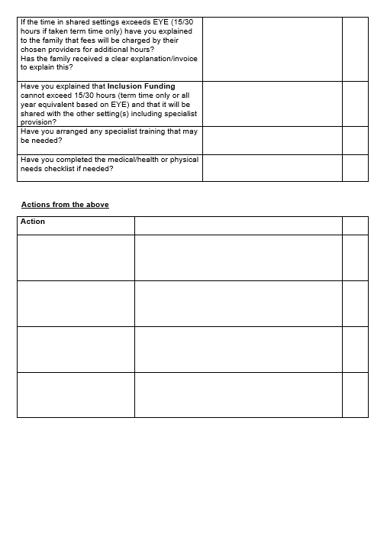
Shared settings checklist

Slide 16
Transition to School
If transition is to be successful, from pre-school to school, preparation should begin early so that there is good communication between the two settings. This needs to be considered carefully by leaders/managers and SENCos who will decide how best to support the transition process.
Transition

Slide 17
The Transition Meeting
Things to consider before the meeting:
Who needs to be invited?
When is the best time to arrange it?
Possible Areas of Discussion between setting SENCo/keyperson and school:
Sharing information with parental consent.
Successful interventions and strategies.
Resources need for continuity of support.
Any possible barriers to learning.
Familiarisation visits (parents and/or key person to school and TA/teacher/Senco to preschool.
Have you written an agenda and shared with parents and professionals before the meeting?
Will it be virtual, face to face or hybrid?
Would the child meet the thresholds for Transition Support Funding (TSF)?

Slide 18
Breakout Activity 2: Planning for transition to school
Joe has been attending your setting for the past year. During that time you raised concerns with parents around his social communication and interaction skills.
Joe struggles with routines and boundaries and his communication skills are limited, particularly listening and attention. He struggles with transitions throughout the session and when the environment becomes too hectic and noisy, will often display this anxiety through his behaviour.
You have supported his needs within the setting using your own targets and making reasonable adjustments based on your observations and assessments and have made referrals to Speech and Language. They have supported with targets and a referral has been made to a paediatrician.
The Health Visitor is supporting Mum at home as she is a single parent and is finding some of Joe’s behaviours difficult to manage. The Children’s Centre Outreach workers are also involved and are supporting with Portage. You have recently put a request in for Inclusion Funding and Joe was awarded Band B.
Notes:
Put in workbook: What steps might you have already taken to support Joe’s needs during transitional times during his sessions and how would you reflect and share this information with his new school to enable a successful and positive transition to school.

Slide 19
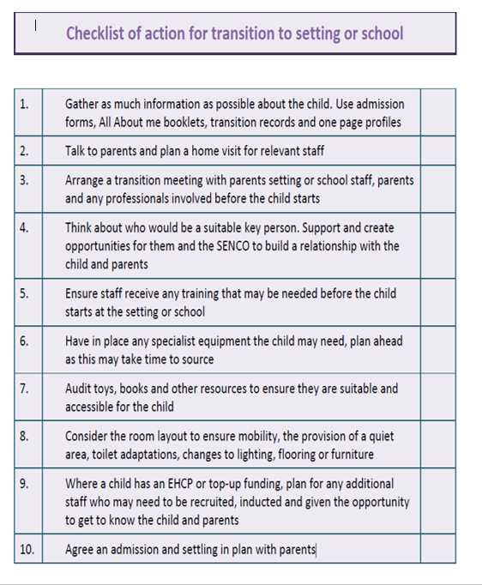

Slide 20
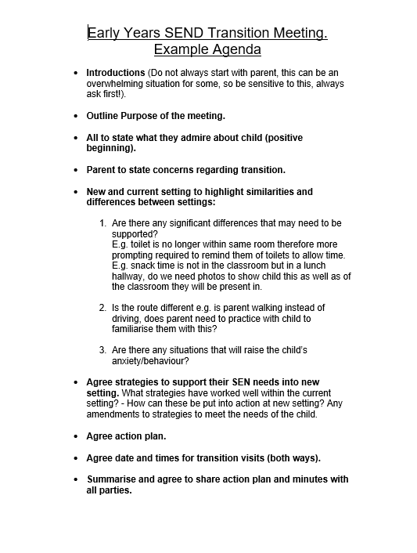

Slide 21
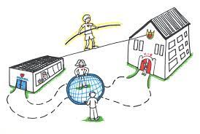
Core purpose of managing effective transitions
The core purpose of managing transitions effectively is to ensure that all children and their parents will experience practical and emotional support through all transition stages to:
facilitate continuity in their care.
support progression in their development and learning.
enhance their well-being.
ensure that they have a positive experience of change.
Transition should be a pro-active, planned process that is flexible enough for individual needs to be met.
Effective transitions occur when there is a commitment from practitioners to develop positive communication links and to share information sensitively and with care.
Trusting and respectful relationships with parents are an integral part of the transition process and help facilitate the seamless transition of children.

Slide 22
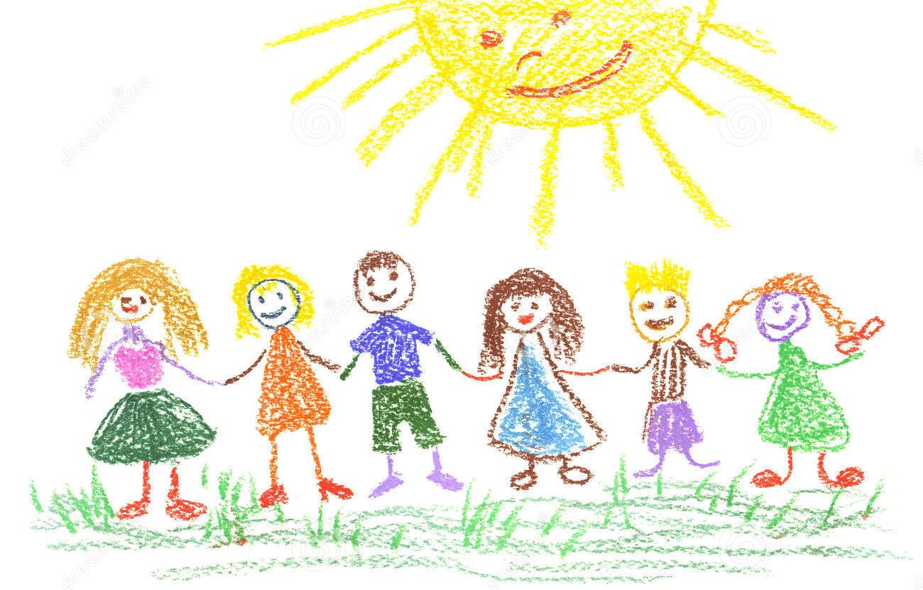
Working in Partnership
The Team Around the Child
What We Can Do Together Far Exceeds What We Can Do Alone

Slide 23
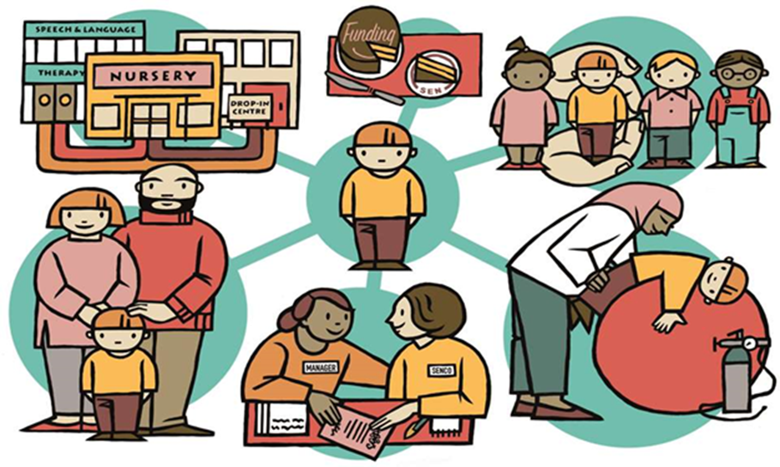
Circles of Connection
Team Around the Child is:
a network of practitioners and professionals who work directly with the child and family. Together they agree a plan and delivery of support to meet a child or young person’s assessed needs.
linked together by a lead professional who co-ordinates the delivery and review of the plan.
central to the family’s voice and must consider the views and needs of each individual family.

Slide 24
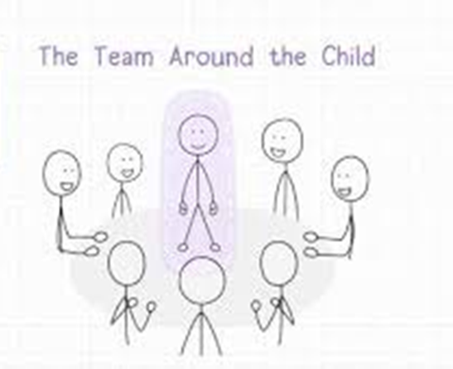
Team Around the Child Meetings
Team Around the Child meetings enable setting SENCo’s and key persons to:
monitor and review children who are at SEN support level every 6-8 weeks.
to work in partnership with parents/carers and other professionals.
focus on the strengths and areas that need support.
develop a clear plan of action with timescales and who is responsible to support the child to learn and develop.
keep the child and family at the centre of everything they do.

Slide 25
Being prepared allows for smooth running's….
First Thoughts:
Is there a focus?
Do you feel confident?
Who, Where and When?
Any requirements?
Agenda:
Liaise with family and professionals.
Review progress
Before the meeting:
Send out invitations and agenda
Ask for contributions

Slide 26
Getting off to a great start….
Ensure that before the meeting whoever is attending from setting is covered by staff and able to fully focus on meeting.
Give yourself, parents and all attendees time.
Offer breaks if needed.
Have a clear structure, be familiar with it and include sharing the Local Offer.
If there is an interpreter address the family and not them.
Make sure the family have a clear understanding of everything being discussed.
Think about making the environment comfortable and how to make everyone feel at ease.
Allow everyone to have their time to talk, starting with the family.
Welcomes/Introductions, Thank yous and explain how the meeting will run.
Check Times/Contact List

Slide 27
Ending on a high….
Set a clear plan of action with timescales and who is responsible.
Ensure parents fully understand everything discussed.
Arrange next meeting.
Thank everyone for attending and allow parents time if needed.
Securely share TAC notes with all attendees.
Remember confidentiality!!

Slide 28
Tricky Conversations
…throughout the early years, if a child’s progress in any prime area gives cause for concern, practitioners must discuss this with the child’s parent and/or carers and agree how to support the child. Practitioners must consider whether a child may have a special educational need or disability which requires specialist support. They should link with, and help families to access, relevant services from other agencies as appropriate.
DfE Statutory Framework for EYFS, para 1.6
Parents’ reactions vary enormously when you raise concerns about their child and cannot easily be predicted. It is therefore, helpful for practitioners to plan carefully for the meeting.

Slide 29
Breakout Activity 3: Tricky Conversations
•What might be some useful ‘openers’ to begin the conversation with parents?
•What could you do before, during or after the discussion to help parents feel comfortable during your conversation?
•How would you ensure that the conversation was two-way?
•What strategies could you use to involve parents in the discussion?
•What would you do if parents asked a question during your conversation that you didn’t feel able to answer?
•How might you support a parent who appeared disengaged in your conversation?
•What are some of the potential challenges you may face in a conversation with a parent and how can you overcome these?
Notes:
In workbooks: Each room has been allocated one question: 10 mins to discuss – 15 mins feedback

Slide 30
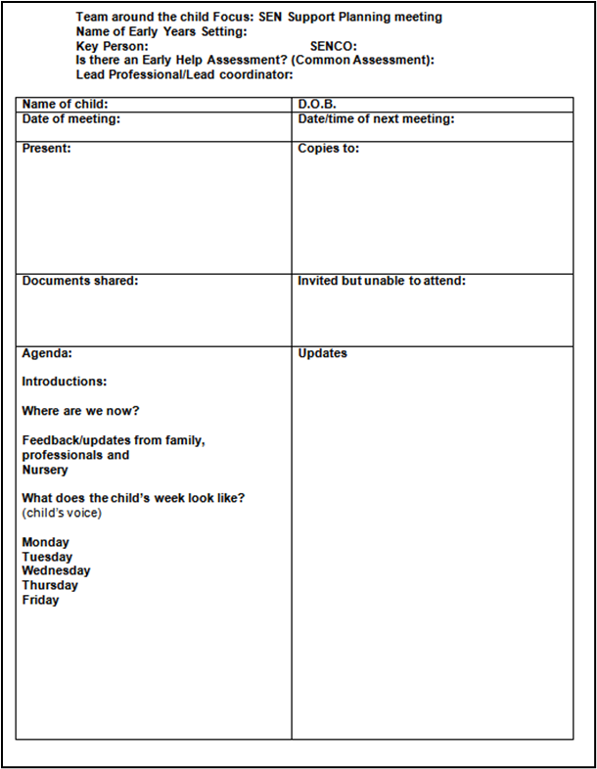
Supporting Resources

Slide 31
Lets Remember….
The SEND Code of Practice (2015) clearly lays out the actions early years settings need to take to identify and support all children with SEND. Part of this is an aim to increase the participation of children with SEND and their parents in decision making, giving them more choice and control over their support.
One size does not fit all. Use these guidelines and plan using your knowledge and relationship with the family to guide you.

