Slide 2
Hello Everyone ☺ Please be familiarising yourself with the Zoom Training Etiquette while you wait for the training session to begin.
Please ensure that where possible you are wearing headphones as this will keep distractions and external noise levels to a minimum
Be open to and respectful of other people’s opinions and suggestions
Please remain muted until the session leader advises you to unmute. This avoids any difficulty with overlapping speech.
Please be mindful to listen to your colleagues when they are voicing their ideas or sharing experiences!
It may be that there will be anecdotal references made to families and children with which you are working. When referring to particular children please use initials only.
Please remember that this information is confidential and should not be discussed outside of this Zoom room

Slide 3
Early Years Area SENCo Team
That’s the SENCo’s Job?
Creating and embedding a whole setting, inclusive, strengths-based approach to supporting children (0-5) with SEND in B&NES
Designed, Created and Delivered by B&NES Early Years Area SENCo Team:

Slide 4
Aims
Day 1: By the end of this session attendees will:
Be able to reflect on ethos, visions and values and SEND policy at your own setting.
Understand the importance of enabling all members of your early years setting community to feel included, involved, motivated and valued.
Recognise and reflect on practitioner skills and knowledge, particularly the key person, to ensure they understand their crucial role in supporting all children, particularly those with SEND.
Recognise the importance of enabling the whole setting team to understand the importance of creating an inclusive, enabling environment and celebrate each child’s learning journey using a celebratory, strengths-based approach.

Slide 5
Part 1: Building solid foundations
Creating and embedding a whole team inclusive ethos and vision

Slide 6
Not just the SENCo’s job!
A whole team approach to supporting Inclusion
It is not and should never be one person’s responsibility alone to ensure that settings are inclusive. Although the updated SEND Code of Practice (2014) suggests that primarily it is the strategic role of the Special Educational Needs Co-ordinator (SENCo), if a setting is going to be fully inclusive, it needs every member of the team to be on board. This begins with the ethos of the setting and its fundamental aims that relate to all families and children
(Brodie and Savage: Inclusion and Early Years Practice 2015)

Slide 7
Breakout Activity 1:
Introductions and Ethos discussion
5 mins
Share with your group you setting's ethos/vision?
Questions to consider:
When was it created and who by?
Are all staff and parents aware of it? Is it displayed?
How do you embed it in to your daily practice?
Notes:
Once you have an ethos/vision statement, it’s vital that you embed it into your daily practice – it’s not meant to be purely for show on your noticeboard, website or social media pages but should be at the heart of all that you do.

Slide 8
Ethos and Vision
An inclusive ethos should:
Reflect the values the setting seeks to promote
Respect all children and parents – trying to support them or having knowledge to be able to signpost to professional services
Encourage and inspire all children
Support children to feel secure and that they belong
Develop inclusive policies and procedures as a ‘whole team approach’
Ensure that everyone's’ voice is heard, including those of parents and children
Create an environment which reduces barriers to learning
Promote positive relationships between adults and children
The fundamental character or spirit of a culture; the underlying sentiment that informs the beliefs, customs or practices of a group or society

Slide 9
Penn Green Vision Statement
Inclusive Practice and Equality of Access
We believe that every child and adult has something unique that they bring to the centre
We value their contribution and aim to nurture and develop each individual
We respect, value and celebrate our differences
We support each child’s well-being, self image and confidence in their abilities to learn and achieve
We recognise that we all learn from each other
Everyone has a fundamental right to a fair and equal education

Slide 10
Ethos, Vision and Values
Supporting whole staff understanding
It is important that all of the staff have clear understanding of the philosophies behind the ethos statement, so that they feel confident putting it into practice.
Inductions, training and reflective practice will help to support this as well as modelling from those who created it.
Owners and/or manager will usually feel more confident understanding the ethos statement and explaining it to staff and parents, it may help staff if you simplify it to a set of bullet points.
These could then be displayed throughout your setting so that those core values are a visible daily reminder.

Slide 11
Creating a SEND policy
Making it personal, accessible and visible

Slide 12
Why do we need a SEND policy?
The SEND policy is the most important document that an early years setting develops when determining how they will meet the special educational needs of the children in their care.
It should reflect the statutory requirements, inclusive ethos and actual day to day practice of the setting.

Slide 13
SEND policy: What to include
Mention the legal framework and guidance that form the basis of the policy and practice
Define what is meant by SEND
Include a statement of intent
Talk about how you identify SEND
Working with parents
Working with outside agencies
Staff training and resources
Role of the SENCo
Explanation of Graduated Approach and SEN Support
Information about EHCP
Consider what is not SEN but may impact on progress and development.
Storing and managing information

Slide 14
Breakout Activity 2:
SEND Policy
Group discussion reflecting on own existing SEND policies
Is your policy personalised to your setting’s approach to supporting and including all children with SEND and their families?
How do you ensure that parents are aware of what is in your SEND policy?
How do you ensure that what is written in your policy is reflected in the day to day provision at your setting
Have practitioners/ room leads been involved in the creation/development of the SEND policy – how do you ensure that they know and understand what it means and their role within it?

Slide 16
Including and Involving Parents
Help parents to understand ‘the system’ and explain what you are doing and why.
Share information with parents about how things work e.g. admissions, procedures for early identification, referrals, transitions
Parents need to know who they should go to when they need to discuss important issues regarding their child
Make sure parent’s know and understand the role of the key worker, setting SENCo and any Advisory Support staff
Make sure parents have a copy of your relevant policies such as settling in and SEND
Try not to use jargon or acronyms as parents are sometimes embarrassed to say they don’t understand.

Slide 17
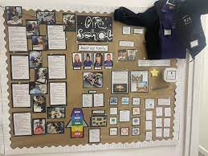
Sharing information with parents:
Making it visible
At your setting:
Meet the team display/poster with biographies and named SENCo
Bullet pointed Vision/Values display on parent notice board
Accessible SEND policy document with SENCo named.

Slide 18
Sharing information with parents:
Making it visible
Website/social media
Setting staff team photos and information
Identified SENCo
SEND policy – downloadable/printable
Signposting LA Local Offer

Slide 19
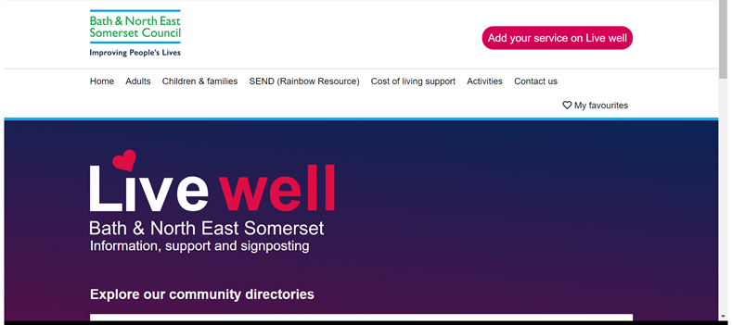
B&NES SEND Local Offer
What is the Local Offer?
The SEND Local Offer gives children and young people with SEND, and their families, information about what support services the local authority think will be available in their local area. Every local authority is responsible for writing a Local Offer and making sure it is available for everyone to see.
https://livewell.bathnes.gov.uk/

Slide 20
Practitioner Key Skills and Knowledge
SEND assessment in the Early Years requires practitioners to have key skills. Accessible training is imperative to enable Early Years practitioners to understand and develop the range of skills needed to undertake SEND assessments.
Practitioners must be able to:
• access the current Statutory Framework for the EYFS and have a sound working knowledge of the whole framework
• have a sound working knowledge of the current SEND Code of Practice
• have a clear knowledge and understanding of their setting’s SEND policy and Graduated Response
• engage parents and carers in a child’s learning and development

Slide 21
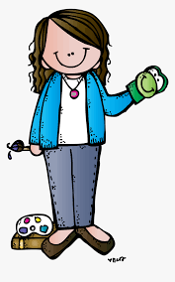
Shining a light on the key person role
Parents and child
Provider
Manager
SENCo
Key Person

Slide 22
Chat Box Question
Why is the key person so important when supporting children with SEND in Early Years settings?
Type one reason into the Chat Box

Slide 24
Being an Inclusive provider
To be an inclusive provider, early years settings should be proactive at challenging and addressing any barriers to inclusion such as negativity, conscious and unconscious bias, and stereotyping. A fairer and more equal society benefits everyone and supports young children’s development, health, education and well-being.
By constantly reviewing policy and practice and by asking other staff members “how are we doing?”, early years settings can develop and improve upon their inclusive practice to the benefit of all their learners, staff, parents and communities.
Notes:
Hide this slide use as prompt

Slide 25
Group Discussion
Notes:
Individual: write down
1 strong feature of inclusive practice
1 thing you feel you do less well in inclusive practice
1 way you’d like to develop
Group discussion:
Common ideas Share ideas to support other practitioners on their own self reflection

Slide 27
Part 2: Creating inclusive,
enabling environments
Enabling
Environments
Notes:
Aims : We would like you to go away today with a deeper understanding of how to create a more inclusive and enabling environment. Hopefully you will feel more confident to put strategies and resources in place which will support the individual needs all of your children.

Slide 28
Creating an Inclusive Enabling Environment
Breakout Activity 3:
What do we mean by an Inclusive Enabling Environment ?
Describe what you think an inclusive enabling environment might look like ?
What kind of practice might we see ?
Notes:
We have thought about Inclusive practise and an inclusive ethos, but what do we mean by creating an inclusive enabling environment. 5-10 mins to chat and 5 mins to feedback.

Slide 29
Whole setting Inclusive Practice:
Sandcastle Playgroup
Notes:
Shows how they put this into practice, using Makaton as a whole group, support to those who need physical support- ramps, higher level sandpit for children who need to access it higher, support for the whole family knowing parents well, signposting services to families, linking with professionals , working on EHCP’s, funding, supporting social interactions, benefits other children- breeds empathy and understanding for all children. Any comments ?

Slide 30
Inclusion - The Golden Thread…
Inclusive practice aims to minimise or remove barriers to learning and support to facilitate the success of all learners
Inclusion – means enabling all children with their diverse abilities, for example but not limited to: – Those who are from different countries or ethnic backgrounds. – Those with different religious beliefs or none. – Those with Special Educational Needs – Those with disabilities. – Those who are disadvantaged. – Those with different learning styles. – Those who have different abilities.
Inclusive enabling environments support all children and their individual needs
Notes:
Inclusion should run through everything we do – from inside to outside learning, lining with parents, going on trips – it needs to be the golden thread running through
Inclusive practice support not only the children with additional needs but improves practice for all children.
Planning around individual needs of the children e.g. child in my class who was Hindu – the family brought in different clothes from their culture and the children dressed up making their daughter feel welcomes and valued.
Everyone in the setting learns from each – if guided and modelled by adults, children learn how different people learn in different way. They learn to value difference and not see it in a negative way. For example a little boy I have supported with Autism loved playing with toy aeroplanes. He would naturally go to the basket of planes which had been gathered by the setting. He struggled at times to let other children into the play but the children learnt they were his favourite toy and how he learnt best. If the setting wanted to motivate him for carpet time they included a story with aeroplanes in, if they wanted to focus on counting they printed off pictures of aeroplanes to count. We all learn best when we are interested and motivated to learn – and we all learn in different ways. How do you learn best ? I know I need pictures to help me remember e.g. directions – I cant take in auditory instructions but draw me a map with landmarks and I will find my way !
VAK Learning Style Theory – visual auditory kinaesthetic

Slide 31
Working together to learn about how a child learns best, their strengths and their needs
Key person talk with parents regularly
All about me- with parents
Observe children in different situations and record what you see and hear
What do these observations tell us about the child’s strengths, interests and areas they may need support with?
2 year check
Use the EYFS development Matters/Birth to 5 matters/DEYO and knowledge of child development to help assess and track progress
Use learning journey
What are the child’s characteristics of learning?
Early Years online tracker or similar
Notes:
As settings you do this really well – key person role in this is important as the regular point of contact – as staff you gather lots of information by including parents in conversations about their child, creating an All About Me, observing the child play, assessing, learning about how they learn best.

Slide 32
When inclusion works well, we see…
Staff have tuned into the child, they are listening to their voice
They have appropriate expectations and aspirations
They are starting from where the child is and not where they think they should be
They are accepting of the child’s needs whilst having high expectations for the progress they could make
They are aware of sensory processing needs and other things that may cause anxiety levels to increase
They are flexible and know that all behaviour is a form of communication
Notes:
Voice of the child – pre verbal – communicating,
Progress within their own needs to be valued and celebrated
Anxiety impacts on learning
Stage not age

Slide 33
SEN and Disability
Under the Equality Act 2010 you are disabled if you have a physical or mental impairment that has a ‘substantial’ and ‘long-term’ negative effect on your ability to do normal daily activities
Children and young people with special educational needs and disabilities (SEND) have learning difficulties or disabilities that make it harder for them to learn and will require SEN support
Not all children with special educational needs are considered to be disabled –although SEN and Disability often overlap
A child or young person has special educational needs if they have a learning difficulty or disability which calls for special educational provision to be made for them.
Definition of Disability BANES SEND Strategy 2016-2020
‘’This strategy recognises the social model of disability defined as “disability is not caused by the individual disabled person’s particular impairment but by the way in which society is structured which results in barriers which prevents their full participation and the lack of recognition of the disabled person’s needs and culture”.

Slide 34
Two Models of Disability
The Medical Model:
You’ve got something wrong with you
You’ve got special needs
You can’t see
You can’t hear
You’re incontinent
The Social Model:
The building needs to be adapted
The curriculum must be accessible
Braille will be available
Hearing aids will be available
We have changing facilities
Notes:
Explain:
A little bit about the history of disabled rights and the campaigning that has been done by them and on their behalf in order to achieve more equality. Still a way to go!
Explain:
A little bit about the history of disabled rights and the campaigning that has been done by them and on their behalf in order to achieve more equality. Still a way to go!
1388 The Statute of Cambridge (“Poor Law”): distinguishes between the ‘deserving’ and ‘undeserving’ poor claiming alms. Disabled and older people are considered to the ‘deserving’ and therefore eligible for charity.
1530s The dissolution of the monasteries creates large numbers of beggars, many of them disabled people who had previously been supported by the church. In response the Poor Law Act of 1535 decrees that ‘the poor and impotent’ should be supported by way of voluntary and charitable alms raised locally. This was the beginning of taxation to support the poor.
1601 Elizabethan Poor Law: explicitly defines ‘deserving poor’ as disabled people and children, and included a requirement for each parish to support disabled people and the old – this sets the tone for the next 300 years of ‘state administration’ of disabled people’s lives. Disability was characterised as an individual’s problem and the state’s role was to ‘manage’ them. Many amendments to the Poor Laws follow.
1764 The first ‘special school for deaf children opens.
1886 Royal Commission on the Blind and Deaf: the first official recognition that national government should act on poverty amongst disabled people.
1897 Queen Victoria grants permission for a number of deaf schools
1944 Disabled Persons Employment Act: introduced the ‘green card’ scheme and segregated state workshops and introduces the first legal definition of a disabled person.
1966 Disability Rally in Trafalgar Square, London.
1982 The Commission of Restrictions Against Disabled People (CORAD) report advised that there should be legislation and a Commission to implement it. This was turned down by the Government, but CORAD began the campaign for civil rights legislation that culminated in the Disability Discrimination Act.
1995 After years of campaigning by disability activists, the Conservative Government introduces legislation to outlaw discrimination against disabled people. The Disability Discrimination Act (DDA) is limited in scope and the duty to treat people equally is subject to a reasonableness caveat. The definition of disability is based on the medical model.
2010 The Equality Act 2010 legally protects people from discrimination in the workplace and in wider society. It replaced previous anti-discrimination laws with a single Act, making the law easier to understand and strengthening protection in some situations.
2) This is what has lead to an appreciation of different perspectives and the two models of disability. If we embrace the social model it has implications for how we approach the whole issue of inclusion. . . . . . . . .
2) This is what has lead to an appreciation of different perspectives and the two models of disability. If we embrace the social model it has implications for how we approach the whole issue of inclusion. . . . . . . . .

Slide 35
Social Model of Disability
Notes:
Still not perfect- still little Braille in the environment, access to buildings can be restricted, sign language in the curriculum ? Lots to do !

Slide 36
Inclusive Enabling Environments
‘Friedrich Froebel (early 1800s) compared designing an environment for children to planning an organic and ever-changing garden which can inspire and guide children’s imagination and behaviour.’
‘Margaret McMillan, a pioneer of the British nursery school said ‘We are trying to create an environment where education will be almost inevitable.’
( MySpace, Creating Enabling Environments for young Children, Oxfordshire County Council
Notes:
‘To enable’ – def – to give someone the authority or means to do something – to make it possible…
Friedrick Froebel – responsible for the term ‘kindergarten’ founded the Play and Activity institute in 1847. He introduced the concept of ‘free play’ and the importance of play and activities in a child's learning.

Slide 37
Inclusive Enabling Environments
The environment plays a key role in supporting and extending children’s development and learning.
Inclusive environments are where all experiences are recognised and valued.
They ensure that all children have equitable access to resources and participation
In the EYFS the ‘environment’ is described in terms of three aspects:
The emotional environment, the indoor environment and the outdoor environment.
Notes:
The way we as adults develop the spaces we inhabit to support children's learning.
Valuing all experiences – children with ASD play can be repetitive and routine- but this is supportive got their learning and understanding of the world around them
How to help a child access all areas and resources – how can we adapt as adults and be flexible

Slide 38
Emotional Environment
The emotional environment refers to not just the children but also the staff and parents. Does your setting have a ‘feel good factor’ ? Is there a positive ethos in the setting- and a ‘can do’ approach?
It also refers to the way in which emotions and feelings are supported – are there ways children can let you know how they feel?
Notes:
The space created will affect everyone within it- children will pick up on adults emotions as well as experiencing their own

Slide 39
Emotional Environment
Breakout Activity 4:Emotional Environment
How can can we support children to manage their emotions ?
How can children with SEN, for example children who are pre verbal, let you know how they feel?
Give examples of how you encourage children to let you know how they are feeling
Notes:
Suggest people jot down the questions before the breakout room..

Slide 40
Emotional Environment
Strategies to support children to manage their emotion
Naming a child’s emotion first – I can see you are sad… then give solution – do you need your quiet space ?
Providing quiet/cosy areas to retreat to
Building trusting relationships between staff and children
Using emotion visuals where staff or child can show their emotion by moving a picture or pointing to a picture ( adult facilitation)
Sensory Diet activities to help children keep regulated
Books about emotions
Social stories – by Carol Gray https://carolgraysocialstories.com/social-stories/what-is-it/
Notes:
Social stories are a simple story that describes a social situation and the appropriate way to act in that situation. The story can teach about a certain event (like their first trip to the Dentist), skill (such as sharing), topic (for example, how everybody is different) or behaviour e.g. hair pulling
It follows a prescriptive format which guides children using visuals and simple language to understand the described situation.

Slide 41
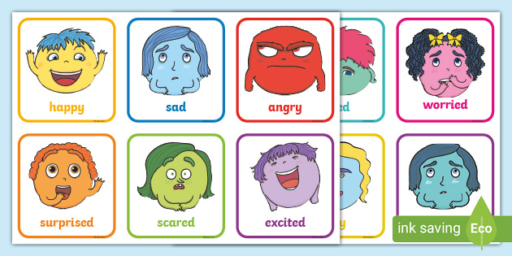
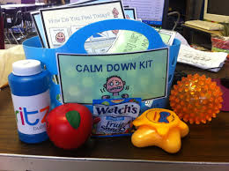
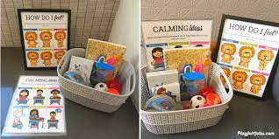
Emotional Environment
Notes:
Sensory diet to help regulate emotions, keep children feeling calm throughout the day – not messy play but physical play – pushing and pulling, carrying a heay rucksack, breathing, squeezing …

Slide 42
Indoor Environment
Rich environments indoors have a positive effect on the quality of children’s learning and development.
Provide a range of activities which serve different purposes: inspire imagination and role play, exploration of personal relationships and feelings, problem solving, quiet time and reflection. Ensure the activities and environment meet the needs of all the children who attend, from very young babies to older children
Consider how you can ensure all children feel welcomed and valued. Close collaboration with parents is vital - including family photos on display boards, singing songs sung in the family home, and providing a comfortable welcoming area with places for a parent to sit with staff and their child
Individual children's needs are considered - What are they interested in and how you could incorporate this into your play environment? How can you help them communicate better? When are they ready to play and ready for rest? When are they intrinsically motivated to learn? How can they have choice and control? Is the environment meeting their individual needs?
Notes:
As adults we need to be flexible and ready to change
Family books area – give example from setting where there was a lovely basket with children’s family books in they could go and get and bring to adults when they needed to or just look at them.

Slide 43
Indoor Environment
Ensure activities and resources are at child height and accessible and use resources which can be moved and used in a variety of ways
Allow children the time and space to focus and reduce noise distractions
Create an environment that is warm, welcoming and nurturing and facilitates a sense of belonging
Offer a range of resources, which are familiar as well as activities that are new to them
Ensure that the activities and environment offer room for outdoor and indoor play, sufficient space for children to move and collaborate, and encourage exploration and risk-taking
Indoor space needs careful planning as it needs to be flexible to accommodate children’s changing interests and needs. Planning for individual children’s needs is vital.
Resources should be of the highest quality and well maintained, clean and relevant to their interests
Engage children in activities to build their emotional resilience and social skills
Notes:
Children are spending a lot of time in your settings. It is important that they feel safe and secure and all children have access to resources available and are supported to access there where needed
Adults guiding and modelling support for resilience and social skills. Adults need to be ready to intervene and join in when needed

Slide 44
Inclusive and Enabling Indoor Environment
Accessibility
Can children access all areas if they have mobility difficulties ? Wheelchair access? Is furniture at the right height? Are steps highlighted for children with a vision impairment ?
Visual supports
Visual Timetable for whole class and individual timetables for children who need them, Now and Next, SCERTS approach – subject verb sentence strip to request help, routines pictures, objects of reference e.g. clean nappy for nappy time
Makaton Signs
Use throughout the day e.g. at story and song time, for requesting e.g. milk/drink
Appropriate resources
Toys and books that reflect all children – children with disabilities, children with different ethnic backgrounds, cultures and religions, sensory resources for children with sensory processing needs, dens for children who need access to a quiet space
Sensory Stories
Providing objects to link with books to make them more real and motivating
Notes:
Examples –
Reasonable adjustments- anticipatory ( Send code of practice 2015)
Access for children in a wheelchair, support for children who need a quiet space e.g. a dark tent, sensory resources
Visual supports as good practice – should be in place all the time…timetable for the class, individual timetables, now and next, SCERTS Approach
children with VI – dolls with glasses, teddy in a wheelchair, books with characters in with a disability
Culturally sensitive
Consider gender awareness
Use specific resources to support individual children e.g. Sensory Stories

Slide 45
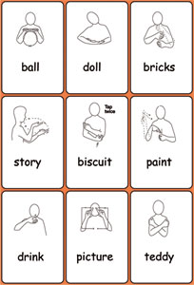
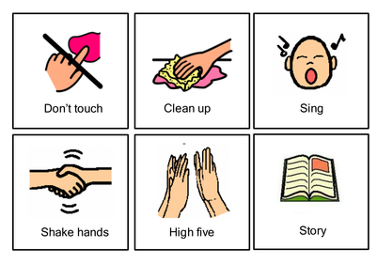
Indoor Environment
Notes:
Now and Next for routines
SCERTS to request help
Makaton signs
Visual Timetables

Slide 46
Inclusive and Enabling Indoor Environment
Sensory Story
Notes:
Ask has anyone used sensory stories before ?
Sensory stories are simple but do need pre preparation and thought. Start with one to one and build to small group then whole class.

Slide 47
Inclusive and Enabling Environments
Focused Strategies - can support children to engage in an adult directed activity built up over time. These may start as very short e.g. 30 seconds building to one minute and so on depending on how the individual child responses
There are a range of possible strategies :
- Activity Box
- Attention Autism
People Games
Sensory Processing activities ( SPARK (EY)
These must be child focused, follow their interests and reviewed and reflected on – how is the child responding? Do resources need to be changed ? Should more children be included in the session ?
Notes:
Modelling of specific activities which can be set up for children at specific times in the day either as one to one, paired or small group depending on the needs of the individual child
Regular slot e.g. same time each day

Slide 48
Outdoor Environment
For children with individual needs and complex disabilities, contact with the outdoors is almost guaranteed to produce stronger responses than the levels normally exhibited during indoor play
It gives children with additional needs opportunities to gain confidence in their physical development
The outdoors offers a rich, multi sensory environment that is meaningful, stimulating and motivating for all young children
Children can move more freely and take risks
Children develop their health and strength and coordination.
When outside, all of a child's senses are stimulated and there is direct contact with the weather, seasons and natural world.
Relationships are different outdoors - children who are quiet indoors are often less inhibited outdoors
Working on large scale activities provides the opportunity for children to cooperate, negotiate and collaborate.
Notes:
Many children needs to be outside for a large part of the day. Behaviours tend to increase when children don’t have access to the outside. Children can show their strengths in the outside that they may not show inside. Time outside can increase children's confidence and self esteem. A boy in one of my classes found inside time challenging. When outside and given access resources which motivated him he became part of the group and his interest in making dens became a whole group activity which he enjoyed and showed others how to make them
Children who feel restrained inside can gain confidence outside- this can impact on their motivation to communicate and interact

Slide 49
Possible Barriers to Accessing the Outdoor Environment
Notes:
Many children needs to be outside for a large part of the day. Behaviours tend to increase when children don’t have access to the outside. Children can show their strengths in the outside that they may not show inside. Time outside can increase children's confidence and self esteem. A boy in one of my classes found side time challenging. When outside and given access resources which motivated him

Slide 50
Inclusive and Enabling Outdoor Environments
Outdoor areas that are accessible to all children- check could a child with mobility needs access all of your outdoor areas?
Uses different levels around spaces to accommodate those who use a wheelchair
Introducing shade, light and texture to make the environment more appealing to children who experience cognitive or sensory impairment
Sensory gardens introduce a natural element to the outdoor area and support children to use all their senses – touch, taste and sound
Quiet spaces are also important, especially for children with sensory needs ( ASD) who may feel overwhelmed in a larger group area.

Slide 51
Inclusive and Enabling Outdoor Environments
Notes:
Sensory activities can support proprioception- when they talked in the video about how a child knows where their body is in space
How outdoor play can support and develop confidence for all children -
Non mobile- more space to explore at their level, creates intrinsic motivation to encourage movement
Sensory development – toes in sand, mud, grass, water tray – information gathered through our feet

Slide 52
Outdoor Environment
The outdoors offers a rich, multi sensory environment that is meaningful, stimulating and motivating for all young children.
Children can move more freely and take risks.
Children develop their health and strength and coordination.
They have an opportunity to experience nature and the weather.
Relationships are different outdoors - children who are quiet indoors are often less inhibited outdoors.
Working on large scale activities provides the opportunity for children to cooperate, negotiate and collaborate.

Slide 53
Inclusive and Enabling Environments
General ideas …
Changing snack to rolling to support children who find it difficult to sit for a whole snack time
Creating a sensory den for a child to retreat to if they have sensory processing difficulties
Sensory Diet/SPARK(EY) activities to support children who are always on the go/become physical when frustrated/need encouraging to join in e.g. sensory, messy play, heavy work – pushing/pulling, wobble cushion
Making sure there is lots of outdoor time to support children who need lots of physical activity
Providing a prop bag to support story time
Are all your children accessing resources and activities in an equitable way ?
Notes:
Sometimes we have to be creative – and like detectives – thinking outside the box about how we can support a child to access the room, snack time, lunch time, story time etc. We need to keep in mind – are we enabling all children to access what we are offering ? How can we help them to access more effectively ?

Slide 54
Final soundbites…
Inclusion is a practice not just a concept …
Aim to embed a strength-based approach and put it into practice…
Use a strength-based approach instead of a deficit approach – social model not medical model …
Notes:
Put our ideas about inclusion into practice …
Focus on child’s strengths
Think about the social model- how can we remove environmental barriers ?

Slide 56
Part 3: Personalising the Strengths based approach
Notes:
Welcome back from lunch, any questions come up since we returned?
Celebrates the fact that all children have learning potential and can make progress with their development and learning no matter what their starting point
Gives opportunity to compliment and support existing strengths and capabilities as opposed to focusing on the area of concern (and staying there!)
The need and the child are separate – however the need is never minimised
It requires a shift in thinking and language used when observing and assessing children and moves away from deficit based approach.
Starting with what is present – not what is absent and focuses on what works for the child
Practitioners and parents to have a ‘can do’ approach to the child's learning journey

Slide 57
Can Do Approach – Strength Based
‘When children with SEND are expected to fit within a linear developmental framework, it can become difficult to celebrate progress and leads to a deficit model (a focus on what the child is unable to do rather than celebrating what they can do). We must recognise and acknowledge that for some children their development and learning will be significantly different from their peers. Practitioners need to champion what children can do, not what they cannot achieve.’
Pen Green: A Celebratory Approach.. 2021
Notes:
Video In Image
Focus on the can do, importance of focusing on a child’s abilities.
Share the quote
Watch the video
feed back about the earlier interventions these children would have. Support from the beginning and seeing there abilities are and the support we can provide. Strength based!

Slide 58
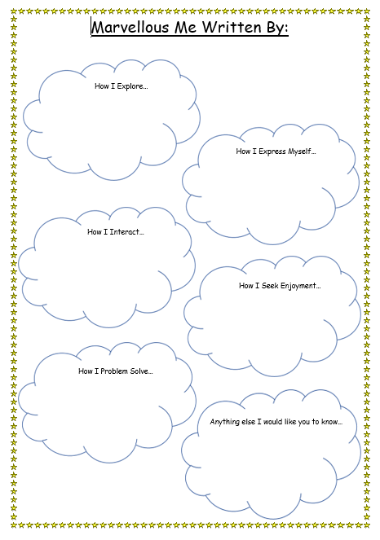
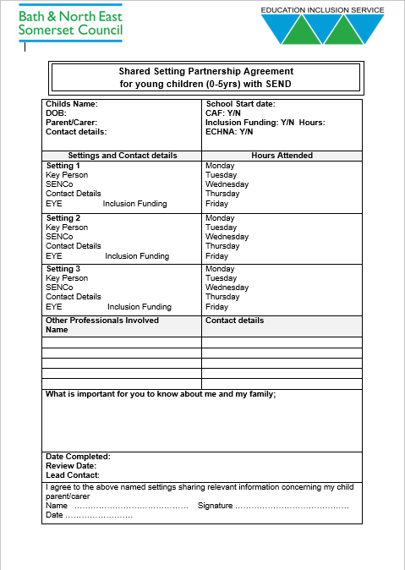
Information Gathering
Notes:
Spoke a lot about on the role of Senco training, To be able to embed strength based from the beginning it needs to start with all children when they start
All about me’s/key information conversations with parents.
Marvellous me, not looking at the age expectations but where the child is now.
Shared placements to make sure that you are not just gathering but also sharing where needed.

Slide 59
One Page Profiles
The One Page Profile is a useful tool that can be powerful for communicating a child’s voice and facilitating their own agency in child centred practice.
The richest profiles are positive and written in a celebratory style. They are not cluttered with acronyms and professional jargon. One way that helps to achieve this is if they are written from the child’s own ‘voice’.
The profile will naturally evolve over time, as the child is always changing and developing; updating the profile allows for it to remain relevant and celebratory as it really does focus on the present.
It is co-constructed from knowledge of those who are involved with the child. This helps to make the voice of the child very clear and apparent through the input of those who know the child well.
Notes:
Once you have gathered information you together start to put implement it into your graduated approach
Read through Slide

Slide 60
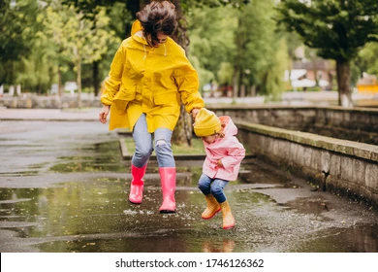
Understanding the Child
‘The paperwork often overrides more in-depth discussions about how we can meaningfully support children. When I visit settings to support children with SEND, I would view observations that were often kept away from the child’s main learning journey. This was because they captured delays or difficulties rather than actual learning. The learning journeys would also have far fewer observations. I would often hear the same narrative that the child didn’t really do enough to be observed. Granted, observing children with SEND can more challenging, but this rarely because they aren’t learning. They are just learning in a way that might not feel known or understood to us.’
Kerry Murphy: A Guide To SEND in the Early Years, p.132.
Notes:
Gathered information from parents but now its important to hear from yourselves as sencos and key people or just early years educators. -Quote
Being able to understand the child.
How can we do that, through observation and putting the time in.
Kerrys Quote, goes on to talk about that onces the conversations happened the practitioners were full on information but came down the confidence.

Slide 61
With this in mind….
How do you observe and celebrate different styles of play?
Why are they important when personalising the strength based approach.
How do you include parent information and work with parents as partners to support a child centred approach?
Notes:
Write down these questions as we are now going to look into some observations on a child
We will then reflect together

Slide 62
Introducing Esme and her play
Esme is two. She lives at home with her mum, dad and older brother. She has a neurological condition which affects her vision and hearing. Esme’s also has a global delay across all areas of her development.
When it was her focus week, practitioner's admitted finding observing her difficult, as her play was described as being ‘repetitive and the same’. Some practitioners felt Esme didn’t really play at all.
The team decided to address the gap in their knowledge and embarked on a journey to celebrate Esme’s play. Once all practitioners understood that Esme’s play did look different to that of her peers, it could begin to be truly valued and an emerging picture of strengths, personal development and learning quickly emerged. The team found it much easier to focus on what Esme could do, rather than what she could not.
The team have identified that Esme enjoys sensory play has a rotational schema and also a trajectory schema – her family report that she loves singing and dancing as well as throwing balls for the family dog to fetch.

Slide 63
Observing Personalised Play
September 2022– Esme notices the dolls pram. She pushes the dolls pram over and lowers herself into a crouching position. She spins the wheels of the pram with her hands, she uses both hands - palmer grasp to spin the wheels. She bobs up and down makes a high pitched vocalisation as the wheels spin. When they stop, she spins them again. After about one minute, Esme moves off to the water tray, she then returns to the pram and spins the wheels again – she repeats this several times. A child moves the pram away and when Esme returns to the area she does not look for the pram – an adult hands her a ball, which she throws. She does not look for it, or try to find it – the adult models this for her and she throws it again.
October 2022 – Esme is outside, she picks up a small ball from the floor, she is beginning to use her fingers more than her palm to grasp the ball. She throws the ball – the ground is slightly sloped and the ball rolls back to her. She picks up the ball and moves closer to the slope, she throws the ball again, towards the slope. The ball returns to her, she stamps her feet and vocalises as the ball returns to her. The adult models the ‘again’ in speech and Makaton. Esme repeats the process and looks to the adult, who models ‘again’ for her. On the third attempt, the adult gets the ball, as it has rolled into a plant and Esme can not see it, Esme makes an attempt at signing ‘again’ and vocalises, the adult praises her, repeats the sign and hands her the ball. Esme remains engaged in this activity for over 5 mins.

Slide 64
Personalised Play Continued
November 2022 – Esme has been showing an interest in playing with peg boards, she places them in their little holes. She is showing an increased interest in books, selecting her own from the rack – her developing fine motor skills means she can now turn the pages independently; she began by using a whole palm swipe, but has now developed the ability to use her fingers to turn the pages. Adults report that Esme can be destructive with books, ripping pages and rolling the paper between her fingers.
Practitioners notice that when washing her hands, Esme has also been ripping paper towels in the bathroom. A box of different textured papers is created and placed within the environment and practitioners model ripping the paper for Esme. If adults notice Esme ripping books for a sensation, they bring her the box of paper and model it’s use. After modelling this for a few days, it is noticed that Esme self accesses this resource – usually after a period of social interaction. Esme currently enjoys the soft tissue paper – she rips fine strips and rolls them between her thumb and forefinger to create a twisted ball. She spends an extended time rolling the ball between her fingers before rubbing the ball of paper into her hair. She then creates a second ball. Once the second ball is created, she holds both balls in her hands she leaves them on the floor. She has been engaged in this activity for almost ten minutes and return to it several times within the session – when she does, she does not rip paper, but picks up the balls she has left and rubs them into her hair.
Notes:
How do you view Esme’s play, Can you see her play? What information have her family shared to support your knowledge? How can you use this to reflect and personalise the strengths based approach?

Slide 65
Group Discussion
Notes:
How do you view Esme’s play, Can you see her play?
What information have her family shared to support your knowledge?
How can you use this to reflect and personalise the strengths based approach?
Can you see how Esme has progressed?

Slide 66
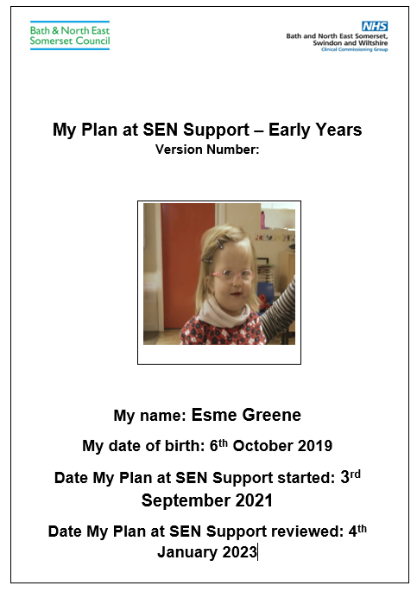
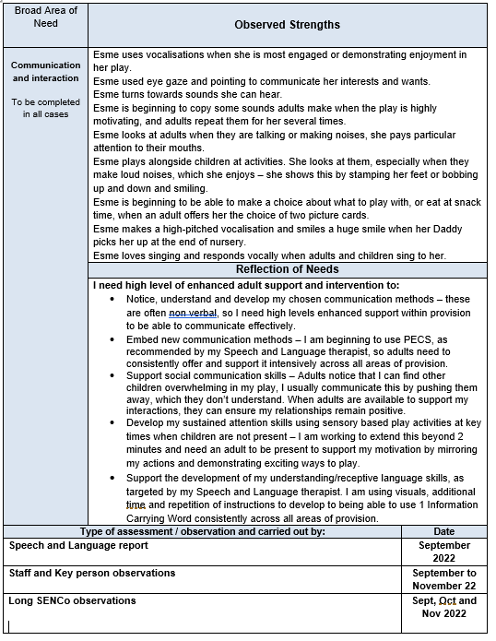
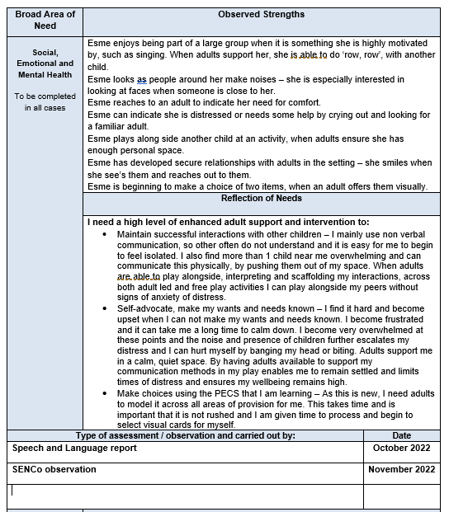
Personalising the Graduated Approach
Notes:
Now what we can do with the information gathered, using it to personalise.
Using photo! Used observations to embed the strength based approach. Making the links, progress made.
Reflected within her my plan, its also really lovely to share your own observations with us.

Slide 67
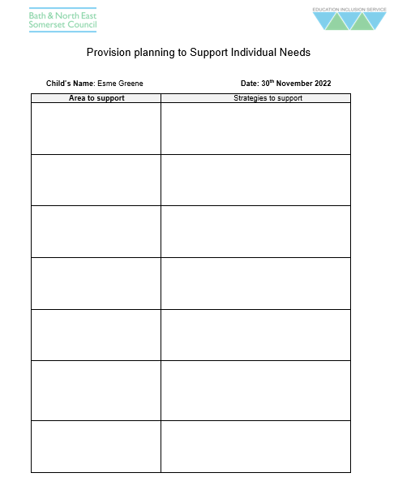
Individual Provision Plan
Notes:
Introduce the individual provision plan, use the reactions to share if you have used it.
Why I find them useful and what they can bring- support to all staff consistency, Oliver’s example and Esme’s blank copy.

Slide 68
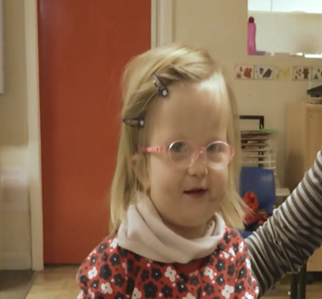
Break Out Activity 5:
Individual Provision Plan
Notes:
Video In Image

Slide 69
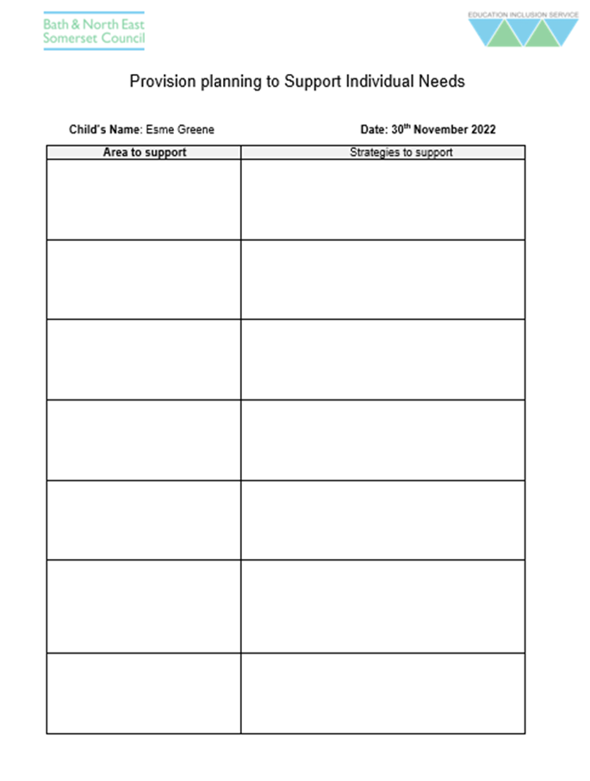
Break Out Activity:
Individual Provision Plan
Notes:
Video In Image
10-15 minutes

Slide 70
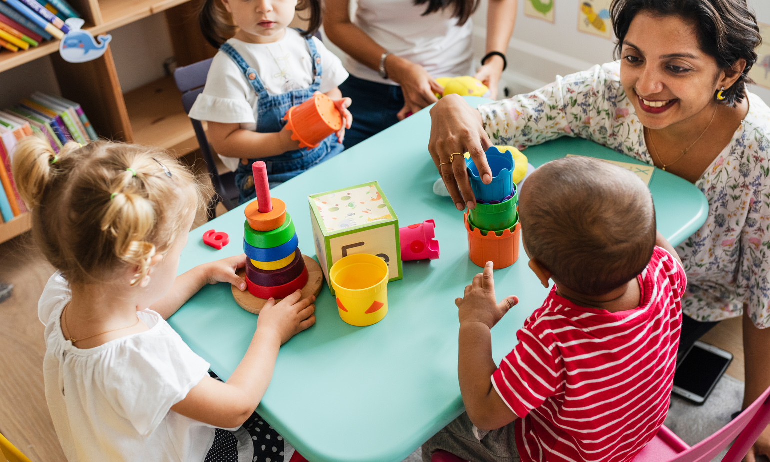
Our Aspiration
We aspire to:
Understand that children's learning is dynamic, complex and holistic.
Acknowledge and value that children demonstrate their cognition and learning in different ways through their play.
Support connection and regulation by honouring all forms of play, communication and learning styles.
Meet the child at their point of development, not assuming they will meet us at our expectation of what their development ‘should’ be, based on that of other children.
Have a ‘can do’, celebratory, strengths based approach to the child's learning journey that presumes competence and doesn’t focus on what is absent, or missing.

Slide 71
Reflective Tools: Inclusive Ethos/Enabling environments

Slide 72
Reflective Tools: Staff Knowledge and Understanding/ Positive Relationships

Slide 73
Group Discussion
Notes:
Individual: write down
1 strong feature of inclusive practice
1 thing you feel you do less well in inclusive practice
1 way you’d like to develop
Group discussion:
Common ideas Share ideas to support other practitioners on their own self reflection

Slide 75
Day 2: Wednesday 11th January 2023
Crossing all the T’s!
Transitions
Team Around the Child
Targets
Tapping into professional agency support: Guest speakers
Health visiting service
Children's Centre Services
Speech and Language Team
SENDIP
SENDIAS
Specialist Preschool Provider – First Steps BOP
Training: Opportunities for whole team CPD

Slide 76
And finally…

