Slide 1
Area SENCo Advisory Team Workshop
Supporting the communication and interaction needs of children with Special Educational Needs and Disabilities

Slide 2
Order of the session
1.30pm – 2.25pm
Welcome, Introductions and Housekeeping
Fi Murray presentation– Specialist SALT PCN Team
Makaton: an inclusive, whole setting approach - Bobbie
Intensive Interactions in Early Years Settings - Lizzie
Using Now and Next Boards – Sam
2.25pm – 2.40pm
Break
2.40pm - 4.20pm
Practical group activities
4.20pm – 4.30pm
Final thoughts and finish

Slide 3
Overall aims
To understand the importance of supporting children's communication and interaction needs using a consistent, inclusive, whole setting approach.
To increase your own confidence, knowledge and skills and then cascade this down to the practitioners at your setting to enable them to develop their own.
To understand that the interventions we will be practising can and should be used throughout each session.
To rejuvenate your enthusiasm and have fun!

Slide 4
Implementing a whole setting approach to using Makaton into your day to day practise

Slide 5
What is Makaton?
Makaton is a unique language programme that uses symbols, signs and speech to enable people to communicate. It supports the development of essential communication skills such as attention and listening, comprehension, memory, recall and organisation of language and expression.
It was first developed in the 1970s by Margaret Walker MBE with support from Kathy Johnston and Tony Cornforth, speech and language therapists who all worked together at the Royal Association for Deaf People – hence Ma-Ka-Ton!
With Makaton, signs are used, with speech, in spoken word order. This helps provide extra clues about what someone is saying. Using signs can help people who have no speech or whose speech is unclear. Using symbols can help people who have limited speech and those who cannot, or prefer not to sign.
https://makaton.org/TMC/The_Makaton_Charity/A_brief_history_of_Makaton.aspx

Slide 6
Who can Makaton help?
Makaton can help children (and adults) who have difficulty with:
Communicating what they want, think or how they feel.
Making themselves understood
Paying attention
Listening to and understanding speech
Remembering sequencing

Slide 7
How Makaton can support a whole setting inclusive approach
Sprinkling the Makaton sunshine!
Incorporating Makaton into daily routines:
Transition times throughout the day.
Whole Group times: Snack, Lunch, Circle time, Hello/Welcome time, Storytime, Singing time.
During free flow
Incorporating specific targets into day to day practise.

Slide 8
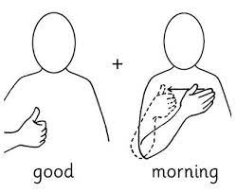
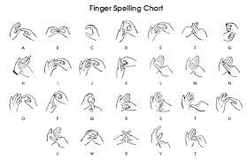
Building confidence
Sign of the Week
Greetings
Finger spelling
Names
Routines

Slide 9
The Makaton Charity
The Makaton Charity aims to ensure that as many people as possible have access to Makaton, to achieve our goal of a truly inclusive society. We:
Provide training to parents, carers and professionals each year
Develop and produce a wide range of printed and electronic resources
Work with others to make information accessible using Makaton symbols
Offer advice and support to families and professionals
Work in partnership with organisations such as the BBC
www.makaton.org

Slide 10
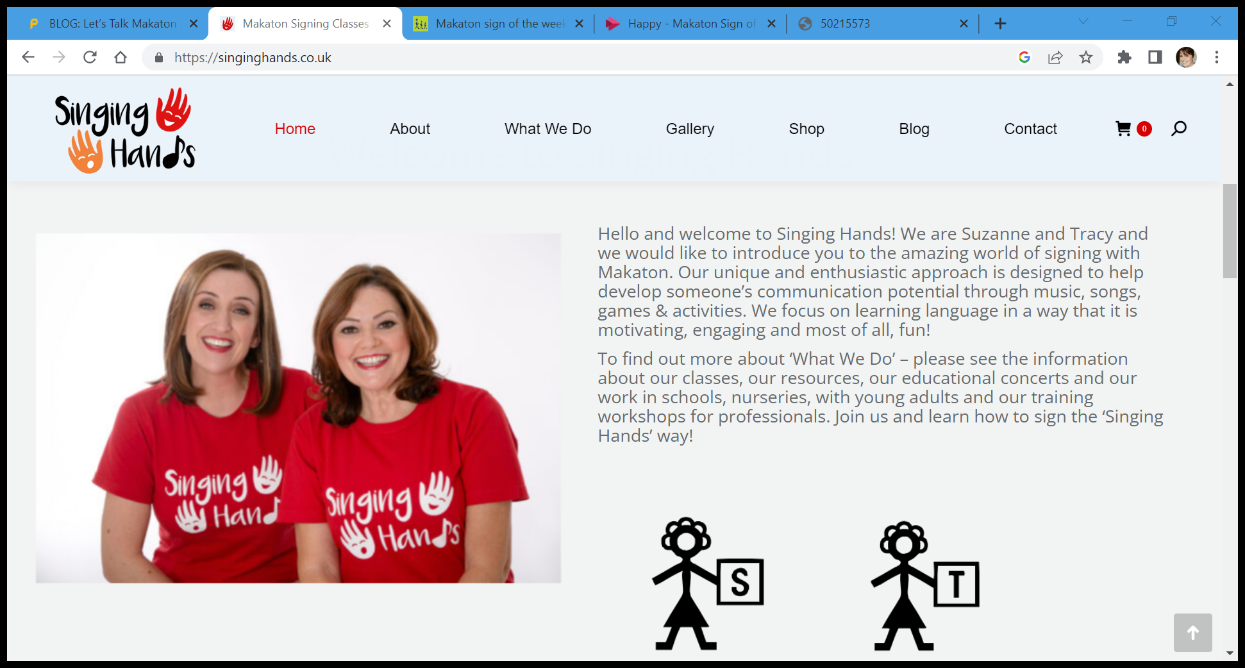
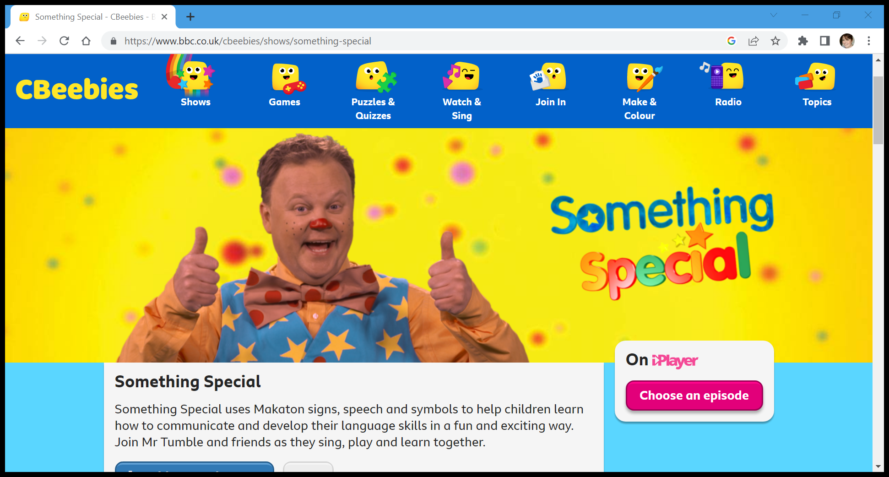
www.singinghands.co.uk
https://www.bbc.co.uk/cbeebies/shows/something-special

Slide 11
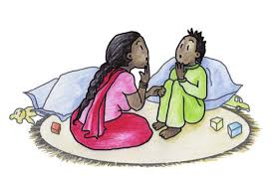
Intensive Interactions

Slide 12
Intensive Interactions – What is it?
Intensive Interaction is a play based approach, developed in the throughout the 1980’s in the UK by Dr’s Dave Hewett and Melanie Nind, who were working at a hospital school for children with learning difficulties.
The Intensive interactions approach is built on the way we observe and respond to the actions and noises of children. It allows us to interpret and value these as communication, enabling the child and their communication partner to connect and enjoy each other’s company more fully.
Intensive Interaction is two-way communication and can be used at all times in all environments.
Notes:
Read the Dave Hewett background info.
Nind, M., & Powell, S. (2000). Intensive interaction and autism: Some theoretical concerns. Children and Society, 14(2), 98-109. https://doi.org/10.1111/j.1099-0860.2000.tb00158.x.

Slide 13
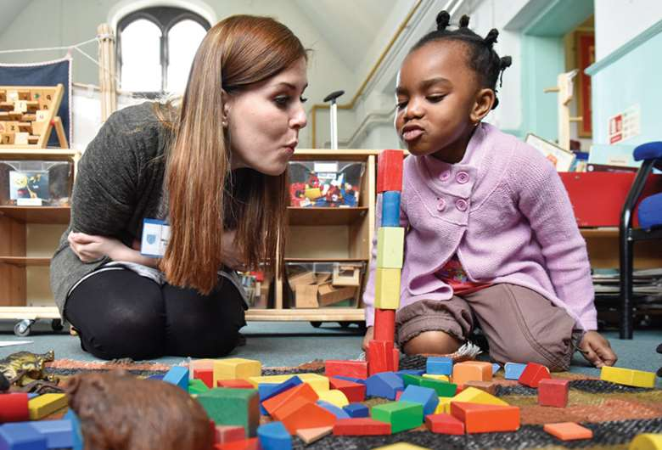
Intensive Interactions – Who can benefit?
Intensive Interaction can be useful for children and adults with:
A range of learning difficulties or developmental differences.
Multi-sensory impairments.
A diagnosis of autism.
A range of self-stimulatory or socially isolating behaviours.
Behaviour that challenges.
It can also be useful for children who are highly social in many ways, but still need to develop social skills such as turn taking, sequences of social behaviours, using facial expressions and eye contact and developing the use of vocalisations.

Slide 14
Intensive interactions – Why is it important?
We know that young children develop social awareness and learn to communicate in the early years but this isn’t always a linear path for all children.
Intensive interactions can support a child by enabling them to develop relationships and connection with you based on their own interests and choices in play.
The approach supports them to be aware of others in an interaction, develops turn taking and an enjoyment of spending time with someone.
Intensive interactions can help to facilitate the development of social communication skills, such as facial expressions and respectful eye contact.
Intensive interactions also supports emerging speech development and shared attention skills.
It also aims to reduce repetitive and self injurious behaviours.
The claim is that intensive interaction helps children learn how to engage with other people for progressively longer periods in gradually more complex and diverse activities.

Slide 15
Intensive interactions and the broad areas of need
Area of need | Evidence
Communication and Interaction | Enjoying being with another person Attention and concentration Using voice as a powerful tool Using facial expression Choosing to use eye contact autonomously Choosing to vocalise Developing vocalisations into sounds and speech
Cognition and learning | Learning sequences of an activity Can allow adults to value where a child’s learning is situated more effectively.
Social, Emotional and Mental Health | Enjoying being with another person Developing an ability delay gratification or wait Taking turns in exchanges of behaviours Sharing personal space Learning to regulate emotions and arousal levels Values personal play and supports community inclusion
Physical and sensory | Can be used by all children – inclusive, Not ableist Can be used to evidence physical gains

Slide 16
Intensive Interactions as part of a whole setting approach
Intensive Interaction is an approach that can be easily used to develop a whole setting approach to supporting children with SEN. It can be used by all adults and can happen anywhere at any time. You don’t need additional resources or adults to deliver it.
Holistic as it centres the child’s interests and natural play choices, valuing the interconnected nature of development. This can take many different forms and is not limited by a resource pack.
Child centred and child led as the interaction goes at the child’s pace and is led by them. You watch and then respond to what the child does by imitating and joining in. The session stops when the child has had enough. To start with, the interaction might last just a few minutes, but they get longer as the child’s skills develop.
Situates connection as a cornerstone for development, from which many other skills can be developed. Supports social communication respectfully and values individuals preferences for social interactions.
Celebratory as it values a child's autonomy, skills, play choices and style. It meets the child at their level of development and can be used to reflect a journey of development.

Slide 17
Clips and useful resources
Dave Hewett on youtube – clips and more information
Intensive Interaction Foundation
Rosie and her dad clip
Esme and the gardening tray
Mencap information sheet on Intensive Interactions

Slide 18
Using Now and Next boards

Slide 19
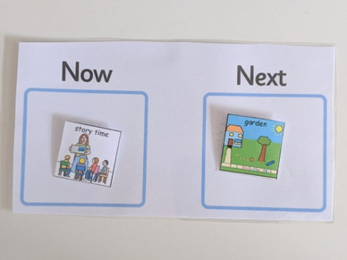
What are Now and Next Boards?
A now and next board is a visual aid to help children sequence events and transition from one activity to another. The ‘Now’ section goes on the left, and the ‘Next’ section goes on the right. There is also room on the back for any ‘Finished’ pictures.

Slide 20
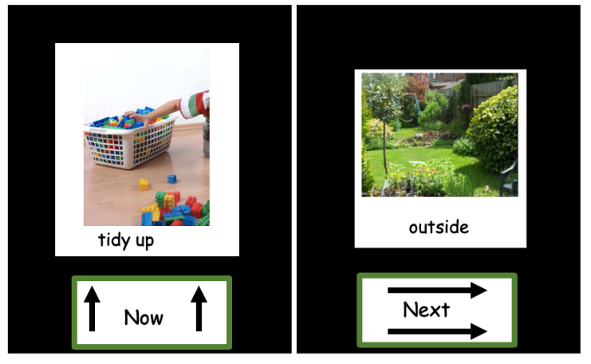
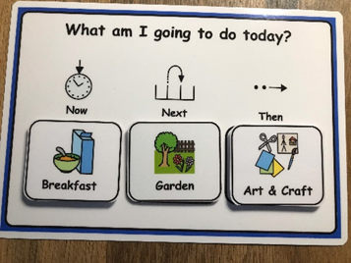
What are Now and Next Boards?
Photographs
Objects
Pictures/Symbols
Black and White Line Drawings
Children’s understanding of visuals develops in the following order: Objects, Small World Objects, Photographs, Pictures/Symbols, Black and White Line Drawings, Words, Phrases and Sentences
Notes:
They can come in many different shapes and sizes. The type of now and next board you might use will be dependent on the children and we should recognise that children’s understanding of visuals develops in the following order: Objects, Small World Objects, Photographs, Pictures/Symbols, Black and White Line Drawings and so on.
Children in an earlier stage of communication development will find it easier to understand visuals such as objects. Objects can be used alongside photographs to support them with developing understanding later on. As children develop their understanding, you can also add a further section of ‘Then’.

Slide 21
Why are Now and Next Boards important?
Children can have reduced anxiety around transitions.
Children can have reduced frustration around transitions.
Children can develop sequencing skills and familiarity around routines.
Children are supported to engage in activities.
Children can be prepared for changes in a routine which might be out of the ordinary.
Notes:
All children can find it difficult to transition from one activity to another at some point in their lives. Often not knowing what is happening, or what’s coming next can lead to anxiety or frustration. Now and next boards are important so children can be supported to feel more relaxed around transitions, develop sequencing skills, familiarity and engage better with activities. They can also be used if the routine is a little different today for any reason, you can develop a “special” card such as a guest visiting, or an event which is out of the ordinary.

Slide 22
Now and Next boards for the individual child
Come down to the child’s level
Gain their attention e.g Using Makaton and “Look”, encouraging their hand to touch the pictures, using a motivating voice.
Using simple direct language “Snack is finished, Now is garden, Next is story”.
Swap pictures over in front of the child or encourage them to pull off pictures themselves.
Finished pictures can go on the back of the board to stop them getting lost.
Notes:
When engaging an individual child using a now and next board, you should approach the child, coming down to their level, and gain their attention such as by using Makaton “Look” and encouraging their hand to touch the pictures with a motivating voice. You need to use simple direct language such as “Now is Snack, Next is Garden. Or Snack is finished, Now is Garden, Next is Story”. Pictures should be swapped over in front of the child to aid their understanding or you can even encourage the child to pull off the pictures themselves. . Finished pictures can go on the back of the board to keep everything together.

Slide 23
How can it be used to support a whole setting approach to inclusion?
Can be used with the whole group
Can be used to prepare for transitions within consistent daily routines.
Can be used to encourage children’s participation in activities which they find difficult.
Supports settings to use consistent language around transitions and routines.
Notes:
A now and next board can be a tool that is used with all children, as many of you will have consistent daily routines, using a now/next board with the whole group is another way of preparing them for transitions. It might also be helpful to include activities which the children favour, after activities which you are choosing for them, so they can see that something they really like is coming up next. It is important to consider the language you will use across the whole setting so this stays consistent. For example, deciding whether you say “Garden Now” or “Outside Now”.

Slide 24
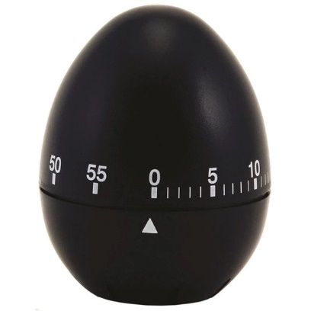
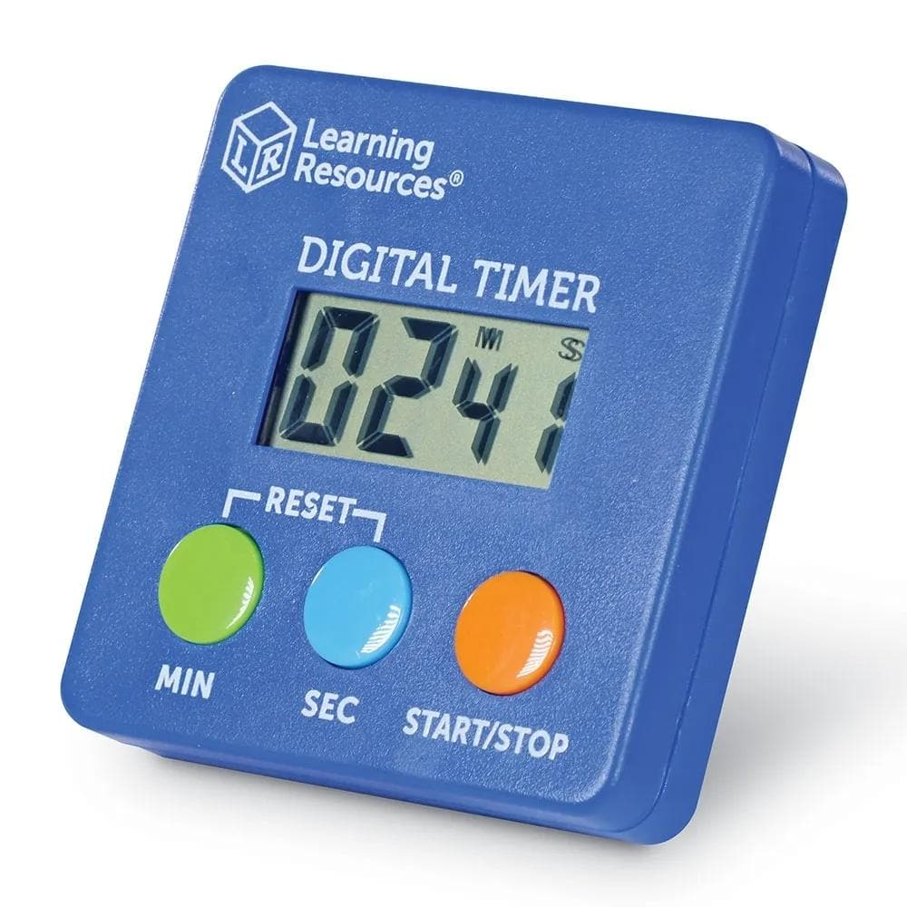
The use of timers with now and next boards
Notes:
Another tool which can be used alongside now/next boards are timers or stop watches. If you know an activity is going to be finishing in 3 minutes, you can give a 3 minute warning with a timer. This supports the child to anticipate that a change or transition is upcoming and helps them prepare. You can also remind the child to look towards the timer at certain points, such as “Look, the sand is nearly finished, or the timer is about to ring!”. It is better to give shorter warnings such as 3 minutes, so that the child doesn’t forget and can anticipate the timings better. Egg timers or digital timers are great because they usually make a noise, which again helps children to recognise the sound as meaning an activity is finished.

Slide 25
Break
15 mins
Time for a catch up with peers
Check with Donna re refreshments

Slide 26
Round up and Goodbye

